Slide 1





Investigating participation in adult learning and education: but how is it measured?

Slide 2

OUTLINE
Introduction TO THE ALE POLICIES PROJECT
LEARNING & WORK INSTITUTE – APiL SURVEY
Methodology
Fındıngs
Dıscussıon & Conclusıon
References
Q&A WITH AUDIENCE

Slide 3

INTRODUCTION TO THE
A.L.E policies project

Slide 4
WHY THIS PROJECT?
Participation rates in ALE in the United Kingdom have been decreasing throughout the 2000s and 2010s.
The number of publicly funded qualification routes started by adults in the UK declined by 70%, dropping from nearly 5.5 million qualifications to 1.5 million by 2020 (Tahir, 2023).
Total participation in further education and skills in 2021/22 decreased by 23.2% compared to 2016/17 (Skills Funding Agency & Department for Business, Innovation and Skills, 2023).
According to the Adult Participation in Learning (APiL) survey of the UK’s Learning and Work Institute (L&W, formerly NIACE, 2023), adult participation rates in learning dropped by 13% to 33% in 2019.

Slide 5
WHY THIS PROJECT?
Use of Fuzzy concepts: lack of consensus on definition adult education, ongoing use of triadic typology of formal, non-formal, informal
Potential lack of reliability of survey results: Widany et al. (2019) demonstrated fluctuations in determinants of participation dependent on data source in Germany, data quality concerns
Lack of insights in trends over time: desire to investigate fluctuations in participation rates in relation to critical junctures such as economic downturns, policy changes, COVID, …
Need to unpack devolved ALE discourses: ALE policies as responsibility of devolved governments in UK, need to engage in home-international comparisons
Situation of data deserts: availability of data uneven across the UK, e.g. PIAAC Cycle 2 only England, implications for evidence-based policymaking

Slide 6
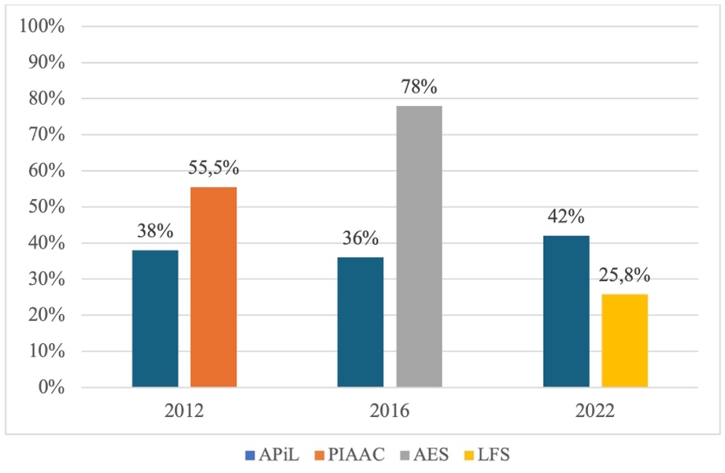
PARTICIPATION RATES AS PUBLISHED IN THE PUBLIC DOMAIN
ESRC – ALE Project
Graph 1: The rates of participation in ALE by APiL, PIAAC, AES and LFS (Desjardins, 2015, p. 5; DfE, 2018, p. 11; L&W, 2023; NISRA, 2023)

Slide 7
THE FOCUS OF evidence-based policymaking
The process of taking scientific evidence into account while designing or revising policy (Goodvin & Lee, 2017)
  to use what is already known from research to design policies
  to build more knowledge to better inform future decisions (Kennedy, 2022)
Efficiency
A key factor in evidence-based policymaking is the nature of the evidence being used. The source of the evidence should have
  credibility,
  scientific rigour,
  relevance,
  independence (Goodvin & Lee, 2017)

Slide 8
PROJECT OBJECTIVES
‘A UK-Ireland Investigation into the Statistical Evidence-Base Underpinning Adult Learning and Education Policymaking’ project
Funded by the Economic and Social Research Council (ESRC) of the UK.
The primary aims of the project are:
  to investigate the nature and consistency of the current statistical evidence-base on ALE across the UK and Ireland,
  to understand the decline in participation in ALE against economic, societal, and political changes,
  and to understand how policymakers make use of the current statistical evidence-base in their decision-making.
The first aim of the project was designed to dig deeper into the conceptual ‘jungle’ of terms like ‘adult education’ versus ‘learning and training’, and the various operationalisations that are used to measure these concepts to inform policymakers about the nature of the evidence underpinning ALE.

Slide 9
LEARNING & WORK INSTITUTE
APiL SURVEY

Slide 10
Learning and Work institute
  L&W was formed in 2016 from a merger between the National Institute of Continuing Education and the Centre for Economic and Social Inclusion
  Independent policy, research and development organisation
  Priority areas:
      Lifelong learning
      Employment and social security
      Essential and life skills
      Pay, progression and job security
      Apprenticeships and technical education
      Social justice and inclusion

Slide 11
Adult participation in learning survey
  The Adult Participation in Learning Survey was launched by NIACE in 1996.
  Development prompted by lack of existing adult learning surveys and adult learning data.
  Longest running and most frequently occurring study of adult learning across the UK.
  In early 2000s NIACE worked with DfE to establish an adult learning participation target, informed by the survey results.
  The survey also informed the development of DfE’s National Adult Learner Survey

Slide 12
METHODOLOGY
  ‘Learning can mean practising, studying or reading about something. It can also mean being taught, instructed or coached. This is so you can develop skills, knowledge, abilities or understanding of something.
  Learning can also be called education or training. You can do it regularly (each day or month) or you can do it for a short period of time. It can be full time, or part time, done at home, at work, or in another place like a college.
  Learning does not have to lead to a qualification. We are interested in any learning you have done, whether or not it was finished.’

Slide 13
Methodology
  Each year, the survey includes:
    Core questions asked every year
    Standard questions which have been asked for a number of years
    Additional, topical questions funded by our research partners
  Yearly reports published on L&W’s website
Core questions | Standard questions
Current or recent participation in learning Future intentions to learn | Main reason for learning Motivation for learning Methods of learning Benefits of learning Barriers to learning (for both learners and non-learners)

Slide 14
Long term trends
  The participation in learning rate generally hovers around 40% of adults
  The findings consistently show that learners are more likely to:
    Be younger
    Be in a higher socioeconomic grade
    Be closer to the labour market
    Be closer to previous learning
  Over half of learners say that they learn for their work or career
  Learners identify a range of wider motivations, benefits and barriers to learning

Slide 15
2023 Survey results
2023 survey showed the highest ever rate of participation in learning
Increase in participation has not been evenly distributed
Regional analysis indicates an increasing gap between highest and lowest performing regions
Continuing impact of characteristics such as age, social grade and labour market status on likelihood of learning
72% of adults who want to change career say they need to develop their skills to do so

Slide 16
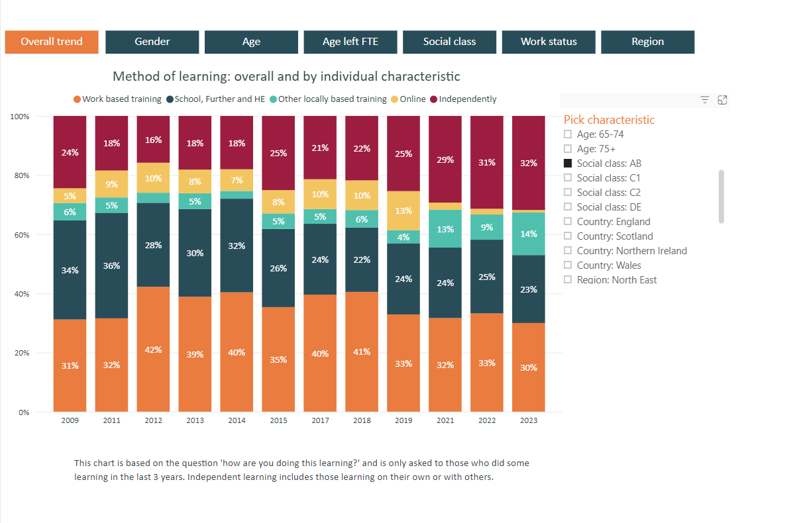
Interactive charts
In 2018 we developed and published a set of interactive charts to enable exploration of the survey trend data. The charts are updated each year upon publication of the survey.
Six charts focused on core and standard questions:
    Rates of adult participation in learning
    Likelihood of future learning
    Methods of learning
    Motivations for learning
    Benefits of learning
    Barriers to learning
Thematic groupings do not 100% match those used in the survey reports

Slide 17
What are the reasons behind THESE varying participation rates?

Slide 18
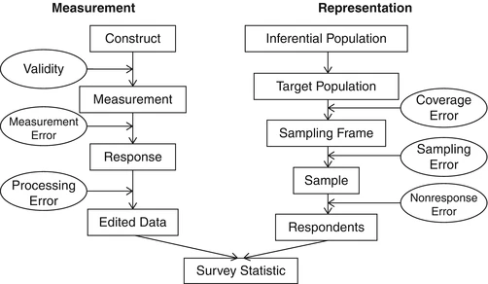
Total Survey Error paradigm
Measurement errors can stem from the validity issues pertaining to the construct that is being measured and processing errors. They can also be caused by the respondents (i.e. providing false information), interviewers, ambiguous wording of the survey questions and various interview factors (Biemer, 2010).
Representation errors can occur due to the insufficient coverage of the target population, sampling errors, nonresponse errors and adjustment errors (Widany et al., 2019).
Figure 1: Total Survey Error paradigm (Groves et al., 2004, as cited in Groves and Lyberg, 2010, p. 856)

Slide 19
OBJECTIVES
The research questions for WP1 are as follows:
What are the methodological differences in four major surveys that collect data on participation in ALE from UK nations?
To what extent do the definitions, concepts, and measurements related to ALE differ across four different surveys (APiL, PIAAC, AES, and LFS) that collect data from UK nations, and how do they map onto concepts of formal, nonformal, and informal learning?

Slide 20
Methodology

Slide 21
Methodology
Four major survey questionnaires were scrutinised by text-based content analysis.
Content analysis sees data as ‘communications that are created and disseminated to be seen, read, interpreted, enacted, and reflected upon according to the meanings they have for their recipients’ (Krippendorff, 2018, p. xii)
The survey documents related to PIAAC, AES, and LFS were obtained from their websites. The documents related to the APiL survey were provided to us by the Learning & Work Institute.
Following the steps proposed by Zhang and Wildemuth (2009), we:
  prepared the data files,
  defined the units of analysis (questions relating to participation in ALE)
  developed a comparative coding scheme,
  coded all the data based on the formal, nonformal, and informal definitions of the International Standard Classification of Education (ISCED) 2011 (UNESCO, 2012),
  ensured the consistency of the codes and located them under themes of formal, nonformal and informal learning.

Slide 22
Background information about the selected surveys
The Adult Participation in Learning (APiL) Survey by Learning & Work Institute
  The APiL has been conducted annually since 1996, with exceptions in 1997, 1998, 2000, 2001, and 2016.
  Around 5000 participants from the four UK nations
The background questionnaire of the Programme for the International Assessment of Adult Competencies (PIAAC) survey of the OECD in 2012
Adult Education Survey (AES) of Eurostat in 2016 – the most recent AES wave
  Waves in 2007, 2011, 2016. UK did not participate in the wave in 2022.
  Wave in 2016 also functioned as the previous National Adult Learning Surveys (NALS) of the Department for Education and Skills of the UK.
Labour Force Survey (LFS) of ONS
  LFS in the UK is managed by the Social Surveys Division of the Office for National Statistics (ONS) in Great Britain and by the Central Survey Unit of the Northern Ireland Statistics and Research Agency (NISRA) in Northern Ireland.

Slide 23
Fındıngs

Slide 24
1. The comparison of the methodological approaches adopted by the four surveys
 | APiL | PIAAC | AES | LFS
The version used in the analysis | 2012, 2017 & 2022 | 2012 (Round1/2011-2012) | 2016 | 2022
Year of initiation | 1996 | 2011 | 2007 | 1973
Sponsorship | L&WI – previously NIACE | OECD | Eurostat | The Office for National Statistics (ONS)
Mode of data collection | CAPI (1996-2019) CATI (2020) CAWI (since 2021) | CAPI | CATI | CAPI (until 2020) CATI (since 2020)
Target population | Aged 17+ | Aged 16-65 | Aged 19-24 (not in fulltime education) 25 and over | Aged 15+
Coverage of the UK nations | England Wales Scotland N. Ireland | England N. Ireland | England | England Wales Scotland N. Ireland

Slide 25
1. The comparison of the methodological approaches adopted by the four surveys
 | APiL | PIAAC | AES | LFS
Sample size | Around 5000 | Eng. – 5131 N. Ir. - 3761 | Eng. – 8822 | Around 100.000
Sampling method | 2011 Census small area statistics and the Postcode Address File | Eng.- Royal Mail list of postal sectors, 2011 N. Ire. – NI(POINTER) database, 2011 | Eng.: Using ONS LFS sampling framework, Three age strata (19-24, 25-64, 65+) | Office for National Statistics (ONS) sampling framework Rotational sampling design (5 age strata)
Frequency of data collection | Yearly (except for 1997, 1998, 2000, 2001 and 2016) | Every 10 years | Varying (4-6 years) | 4 times per year (since 1992)
Reference of time for learning | Current learning and 3 years | 12 months | Both 3 years and 12 months | Both 3 months and 4 weeks

Slide 26
2. The definitions, concepts and measurements related to participation in ALE across the four surveys
 | PIAAC 2012 | AES 2016 | LFS 2022 | APiL
Formal education (FEd) | ✓ Ongoing FEd & FEd in the last 12 months | ✓ Ongoing FEd & FEd in the last 12 months | ✓ Ongoing FEd & FEd in the last 3 months and 4 weeks | ✓ Current learning and any learning in the past 3 years
Nonformal education (NFEd.) | ✓ On-the-job training, seminars, workshops, courses, private lessons, distance education (formal or nonformal) in the last 12 months | ✓ Taught courses, supervised training, adult education classes, evening classes, tuition, seminars, workshops in the last 3 years and 12 months | ✓ Job-related learning (formal or nonformal) in the last 3 months and 4 weeks. Taught classes, on-the-job/ off-the job training, tuition, taught classes in the last 3 months. | ✓ Current learning and any learning in the past 3 years
Informal learning (INFL) | No | ✓ Deliberate learning in various places from various sources via various means in the last 3 years and 12 months | ✓ Self-learning in the last 3 months and 4 weeks | ✓ Current learning and any learning in the past 3 years

Slide 27
2. The definitions, concepts and measurements related to participation in ALE across the four surveys
 | No | Questions | Reference period | Types of ALE
APiL | 1 | Learning can mean practising, studying, or reading about something. It can also mean being taught, instructed or coached. This is so you can develop skills, knowledge, abilities or understanding of something. Learning can also be called education or training. You can do it regularly (each day or month) or you can do it for a short period of time. It can be full-time or part-time, done at home, at work, or in another place like college. Learning does not have to lead to a qualification. We are interested in any learning you have done, whether or not it was finished. Which of the following statements most applies to you? 01: I am currently doing some learning activity now 02: I have done some learning activity in the last 3 years 03: I have studied\learnt but it was over 3 years ago 04: I have not studied\learnt since I left full time education 05: Don’t know/ Refuse to answer | Current & The last 3 years | Formal, nonformal, informal learning

Slide 28
2. The definitions, concepts and measurements related to participation in ALE across the four surveys
Survey | No | Questions | Reference period | Types of ALE
PIAAC 2012 | 1 | Are you currently studying for any kind of formal qualification? | Current | Formal education
 | 2 | During the last 12 months, have you studied for any formal qualification, either full-time or part-time? | The last 12 months | Formal education
 | 3 | During the last 12 months, have you participated in courses conducted through open or distance education? | The last 12 months | Formal or nonformal open or distance education
 | 4 | During the last 12 months, have you attended any organized sessions for on-the-job training or training by supervisors or co-workers? | The last 12 months | Nonformal education (on-the-job training, training by supervisors or co-workers)
 | 5 | During the last 12 months, have you participated in seminars or workshops? | The last 12 months | Nonformal education (seminars or workshops)
 | 6 | During the last 12 months, have you participated in courses or private lessons, not already reported? | The last 12 months | Nonformal education (courses or private lessons)

Slide 29
2. The definitions, concepts and measurements related to participation in ALE across the four surveys
 | No | Questions | Reference period | Types of ALE
AES 2016 | 1-2 | If you think about the last 3 years, that is since …, have you...? / During the last 12 months, that is, since .., have you …? Worked towards or completed a qualification? Worked towards or completed a formal apprenticeship at any level (including trade/advanced/foundation/ modern apprenticeships) which will lead or led to a qualification? Been on any taught courses designed to help you develop skills that you might use in a job? Received any supervised training while you were actually doing a job. By this I mean when a manager or experienced colleague has spent time with you helping you learn or develop skills as you do specific tasks at work? Attended any adult education classes, including evening classes? Attended any courses or received any instruction or tuition in driving, playing a musical instrument, in an art or craft, a sport or any other practical skill? Learnt from a package of materials provided by employer, college, commercial organisation or training provider? Been on any other taught course or received any other instruction or tuition in anything, for example attending a workshops or seminars? None of the above? | The last 3 years/ The last 12 months | 1. Formal education 2. Formal education (apprenticeship) 3. Formal or nonformal job-related training 4. Nonformal education (supervised training) 5. Nonformal education (adult education and evening classes) 6. Nonformal education (psychomotor domain) 7. Nonformal or informal learning 8. Nonformal education (instruction, tuition, workshops or seminars)

Slide 30
2. The definitions, concepts and measurements related to participation in ALE across the four surveys
 | No | Questions | Reference period | Types of ALE
AES 2016 | 3-4 | During the last 12 months, apart from the activities mentioned earlier, have you deliberately tried to learn anything at work or during your free time to improve your knowledge or skills through the following means... / If you think about the last 3 years instead, that is since …, have you deliberately tried to learn anything at work or during your free time to improve your knowledge or skills through ... Learning from a family member, friend or colleague Learning by using printed material such as books or magazines Learning using a computer, tablet or smartphone (either online or offline) Learning through watching television, dvd or blu-rays or listening to the radio Learning by taking guided tours of museums, historical, natural or industrial sites Learning by visiting libraries or other learning resource centres None of these | The last 3 years/ The last 12 months | Informal learning in the last 3 years (through a wide range of people, materials, places, and technology)

Slide 31
2. The definitions, concepts and measurements related to participation in ALE across the four surveys
 | No | Questions | Reference period | Types of ALE
LFS 2022 | 1 | Are you currently working or studying towards any qualifications? | Current | Formal education
 | 2 | Are you on a full or part-time course, a medical or nursing course, a sandwich course, or some other kind of course? | Current | Formal education
 | 3 | In the 3 months since [date] have you taken part in any education or any training connected with your job or a job that you might be able to do in the future (including courses that you have told me about already)? | The last 3 months | Formal or nonformal education (job-related)
 | 4 | And did you take part in any of that education or training in the 4 weeks ending Sunday the [date]? | The last 4 weeks | Formal or nonformal education (job-related)
 | 5 | May I just check, in the last 3 months, beginning [date], has your (previous or current) employer offered you any training or education either on, or away from, your job? | The last 3 months | Nonformal education (on-the-job or off-the job)
 | 6 | (Other than the learning, studying and work-related training you have already told me about) During the last 3 months have you received any other tuition or attended any other taught classes, for work or for yourself? | The last 3 months | Nonformal education (either job-related or not)
 | 7 | During the last 3 months have you taken part in any other learning activities that did not involve taught classes, such as self-learning? | The last 3 months | Informal learning
 | 8 | Did you take part in any of this learning that did not involve taught classes in the last 4 weeks? | The last 4 weeks | Informal learning

Slide 32
2. The definitions, concepts and measurements related to participation in ALE across the four surveys
Deviation from formal – nonformal – informal learning typology and from each other
Dependency on respondents’ understanding of what counts as learning
Ambiguity – LFS (some kind of other course) & PIAAC (open or distance education)
Richness in clues/probes – AES (more probes could have been included.)
Lack of sufficient number of probes – all four surveys (adult education classes, evening classes, videos, apps, podcasts etc.)

Slide 33
Dıscussıon & Conclusıon

Slide 34
MAIN OBSERVATIONS
Our text-based content analysis on the four major ALE surveys indicated that there were substantial differences among all four surveys in terms of how they conceptualise and measure ALE, which can be the underlying cause behind the substantially varying participation rates.
  differences in methodological approaches: reliance on distinctive data collection methods such as CAWI or CAPI
  → need for future research on best ways to capture reliable data
  use of different reference periods to capture participation – ranging from 4 weeks to 3 years,
  → issue of recall problems among respondents
  → participation in ALE typically not on a daily basis
  differences in operationalisation of the participation concept
  → role of context-based questions and probes, e.g. AES versus APiL
  → how do respondents understand learning? role of more structured qualification routes?
  → debates on mapping of questions onto formal, non-formal, informal learning

Slide 35
REFLECTIONS
Surveys like APiL, AES and PIAAC are most specialised ALE data sources but are all cross-sectional, need for further exploration through longitudinal work (e.g. Understanding Society)
Use of different data collection methods and operationalisation of concepts leads to incomparable data and makes it difficult to undertake trend analyses → current project phase on APiL
Recommendation for future streamlining of surveys with options for data linkages, also with administrative data
Exploration of alternatives to survey research, for example randomised controlled trials, big data research and the use of Artificial Intelligence
How do data quality issues jeopardise effective evidence-based policymaking?
Focus of next project phase!

Slide 36
References USED FOR THIS WORK
Beblavy, M., Thum, A. E., Potjagailo, G. (2014). Learning at every age? Life cycle dynamics of adult education in Europe. Studies in Continuing Education, 36(3), 358-379. https://doi.org/10.1080/0158037X.2014.918537
Biemer, P. (1988). Measuring Data Quality. In R. Groves, P. Biemer, L. Lyberg, J. Massey, W. Nicholls & J. Waksberg (Eds.), Telephone Survey Methodology (pp.273-282). John Wiley & Sons.
Bipartisan Policy Center. (2018). Evidence-based policymaking primer. https://bipartisanpolicy.org/report/evidence- based-policymaking-primer/
Boeren, E. (2014). Evidence-based policy-making: The usability of the Eurostat Adult Education Survey. International Journal of Lifelong Education, 33(3), 275-289. https://doi.org/10.1080/02601370.2014.891887
Boeren, E. (2016). Lifelong Learning Participation in a Changing Policy Context: An Interdisciplinary Theory. Palgrave Macmillan.
Campanelli, P., and Channell, J. (1994). Training. An Exploration of the Word and the Concept With an Analysis of the Implications for Survey Design (Research Series, no. 30). Sheffield: Research Strategy Branch, Employment Department.
de Leeuw, E. D., and van der Zouwen, J. (1988). Data quality in telephone surveys and face-to-face surveys: A comparative meta-analysis. In R.Groves, P. P. Biemer, L. Lyberg, J. Massey, W. Nicholls & J. Waksberg (Eds.), Telephone Survey Methodology (pp. 283-299). John Wiley & Sons.
Department for Education. (2018). Adult Education Survey 2016: Research Report. https://assets.publishing.service.gov.uk/media/5b19556740f0b634c6141333/Adult_Education_Survey_2016_research_report.pdf
Desjardins, R. (2015). Participation in adult education opportunities: evidence from PIAAC and policy trends in selected countries – background paper prepared for the Education for All Global Monitoring Report 2015. Los Angeles: University of California.
Dürnberger, A., Drasch, K., and Matthes, B. (2010). Kontextgestützte Abfrage in Retrospektiverhebungen. Ein Kognitiver Pretest zu Erinnerungsprozessen bei Weiterbildungsereignissen. IAB-Discussion Paper, No. 20/2010. http://doku.iab.de/discussionpapers/2010/dp2010.pdf
European Parliamentary Research Service. (2023). Lifelong Learning in the EU. https://www.europarl.europa.eu/thinktank/infographics/lifelonglearning/

Slide 37
Eurostat. (2023a). EU Labour Force Survey: Description of the data collection. https://ec.europa.eu/eurostat/web/microdata/european-union-labour-force-survey#:~:text=The%20EU%20labour%20force%20survey,Trade%20Association%20(EFTA)%20countries.
Eurostat. (2023b). Adult Education Survey (AES) methodology. https://ec.europa.eu/eurostat/statistics-explained/index.php?title=Adult_Education_Survey_(AES)_methodology#Introduction
Felstead, A., Green, F., and Mayhew, K. (1997). Getting the Measure of Training. A Report on Training Statistics in Britain. Leeds: Centre for Industrial Policy and Performance; University of Leeds.
Goodvin, R., & Lee, S. C. (2017). Promises and pitfalls of evidence-based policymaking: observations from nonpartisan legislative policy research institute. Psychology, Public Policy, and Law, 23(4), 490-502. http://dx.doi.org/10.1037/law0000145
Groves, R. M., and Lyberg, L. (2010). Total survey error: Past, present and future. Public Opinion Quarterly, 74(5), 849–879.
Hall, S., Jones, E., Evans, S. (2023). Adult Participation in Learning Survey 2023. Learning and Work Institute. https://learningandwork.org.uk/resources/research-and-reports/adult-participation-in-learning-survey-2023/
Hall, S., Jones, E., Evans, S. (2021). Adult Participation in Learning Survey 2021. Learning and Work Institute. https://learningandwork.org.uk/resources/research-and-reports/adult-participation-in-learning-survey-2021/
Hillage, J., Uden, T., Aldridge, F., & Eccles, J. (2000). Adult Learning in England: A Review. IES Report 369. Grantham Book Services.
Jackson, H., Young, N. A., & Taylor, D. (2021). Beyond question wording: How survey design and administration shape estimates of disability. Disability and Health Journal, 14(4), 101115.
Kennedy, D. (2022). Research and policy: A three-way intersection (Part 1 of 3). Adult Literacy Education, 4(2), 44-50.
Krippendorff, K. (2018). Content analysis: An introduction to its methodology. Sage.
Kuper, H., Behringer, F., and Schrader, J. (ed.). (2016). Development of indicators and a data collection strategy for further training statistics in Germany. Bonn: Bundesinstitut für Berufsbildung. https://www.bibb.de/veroeffentlichungen/de/publication/show/8101

Slide 38
Ladini, R., & Biolcati, F. (2023). Ambiguity in the item wording, ambiguity in the respondents’ comprehension? An experiment on the ‘immigrants/foreign workers’ social distance item in values surveys. Survey Research Methods, 17(1), 63-74.
Learning and Work Institute. (2023). Rates of adult participation in learning. https://learningandwork.org.uk/what-we-do/lifelong-learning/adult-participation-in-learning-survey/rates-of-adult-participation-in-learning/
Link, M. W., and Mokdad, A. H. (2005). Effects of survey mode on self-reports of adult alcohol consumption: A comparison of mail, web and telephone approaches. Journal of Studies on Alcohol, 66(2), 239-245.
Martin, E. (2006). Survey questionnaire construction. Research Report Series (Survey Methodology #2006-13). Director’s Office U.S. Census Bureau Washington, D.C. 20233. https://www.census.gov/content/dam/Census/library/working-papers/2006/adrm/rsm2006-13.pdf
McGivney, V. (2003). Match or mismatch: do the findings reflect the qualitative evidence? In N. Sargant & F. Aldridge (Eds.), Adult Learning and Social Division: A Persistent Pattern (Vol. 2), (pp. 92-99). NIACE.
Northern Ireland Statistics and Research Agency (NISRA). (2023). National statistics: Highest qualification and participation in education and training 2022. https://www.nisra.gov.uk/publications/highest-qualification-level-2022
OECD. (2010). PIAAC Background questionnaire MS version 2.1 d.d. 15-12-2010. https://www.oecd.org/skills/piaac/Background%20Questionnaire%2015DEC10.pdf
OECD. (2016a). Technical Report of the Survey of Adult Skills (PIAAC) (2nd ed.). https://www.oecd.org/skills/piaac/PIAAC_Technical_Report_2nd_Edition_Full_Report.pdf
OECD. (2016b). The Survey of Adult Skills: Reader’s Companion, Second Edition, OECD Skills Studies, OECD Publishing, Paris. https://www.oecd.org/publications/the-survey-of-adult-skills-9789264258075-en.htm
Office for National Statistics. (2022a). LFS User Guides. 2022 Update: Volume 1: Background and Methodology. https://www.ons.gov.uk/employmentandlabourmarket/peopleinwork/employmentandemployeetypes/methodologies/labourforcesurveyuserguidance#2022-update

Slide 39
Office for National Statistics. (2022b). LFS User Guides. 2022 Update: Volume 2: LFS Questionnaire. https://www.ons.gov.uk/employmentandlabourmarket/peopleinwork/employmentandemployeetypes/methodologies/labourforcesurveyuserguidance#2022-update
Owusu-Agyeman, Y. (2019). An analysis of theoretical perspectives that define adult learners for effective and inclusive adult education policies. International Review of Education, 65(6), 929-953.
Popovic, K. (2010). Methodological aspects of surveys on participation in adult education and learning. Andragoške Studije, 1, 35-46.
Powell, R., Smith, R., & Reakes, A. (2003). Defining common issues across Europe for adult education. Slough: National Foundation for Educational Research. https://www.direitodeaprender.com.pt/elwaweb/doc_bin/Research%20Reports/DEFINING%20COMMON%20ISSUES%20ACROSS%20EUROPE%20FOR%20ADULT%20EDUCATION.pdf
Ronsenbladt, B. (2010). Adult education and training in comparative perspective – understanding differences across countries. Statistics in Transition, 11(3), 465-502.
Skills Funding Agency & Department for Business, Innovation and Skills. (2023). Further education and skills. https://explore-education-statistics.service.gov.uk/find-statistics/further-education-and-skills/2021-22
Tahir, I. (2023). Investment in Training and Skills. Institute for Fiscal Studies. https://ifs.org.uk/sites/default/files/2023-10/IFS-Green-Budget-2023-Investment-in-training-and-skills.pdf
Widany, S., Christ, J., Gauly, B., Massing, N., & Hoffmann, M. (2019). The quality of data on participation in adult education and training. An analysis of varying participation rates and patterns under consideration of survey design and measurement effects. Frontiers in Sociology, 4, 71.
Zhang, Y. and Wildemuth, B. M. (2009). Qualitative analysis of content. In B.M. Wildemuth (Ed.), Applications of Social Research Methods to Questions in Information and Library (pp. 1-12). Libraries Unlimited.

Slide 40

Q&A with audience
PresenterS: PROFESSOR ELLEN BOEREN, DR CORIN EGGLESTONE, Dr. Betul BABAYIGIT
Q&A facilitator: DR SHARON CLANCY

