Slide 1
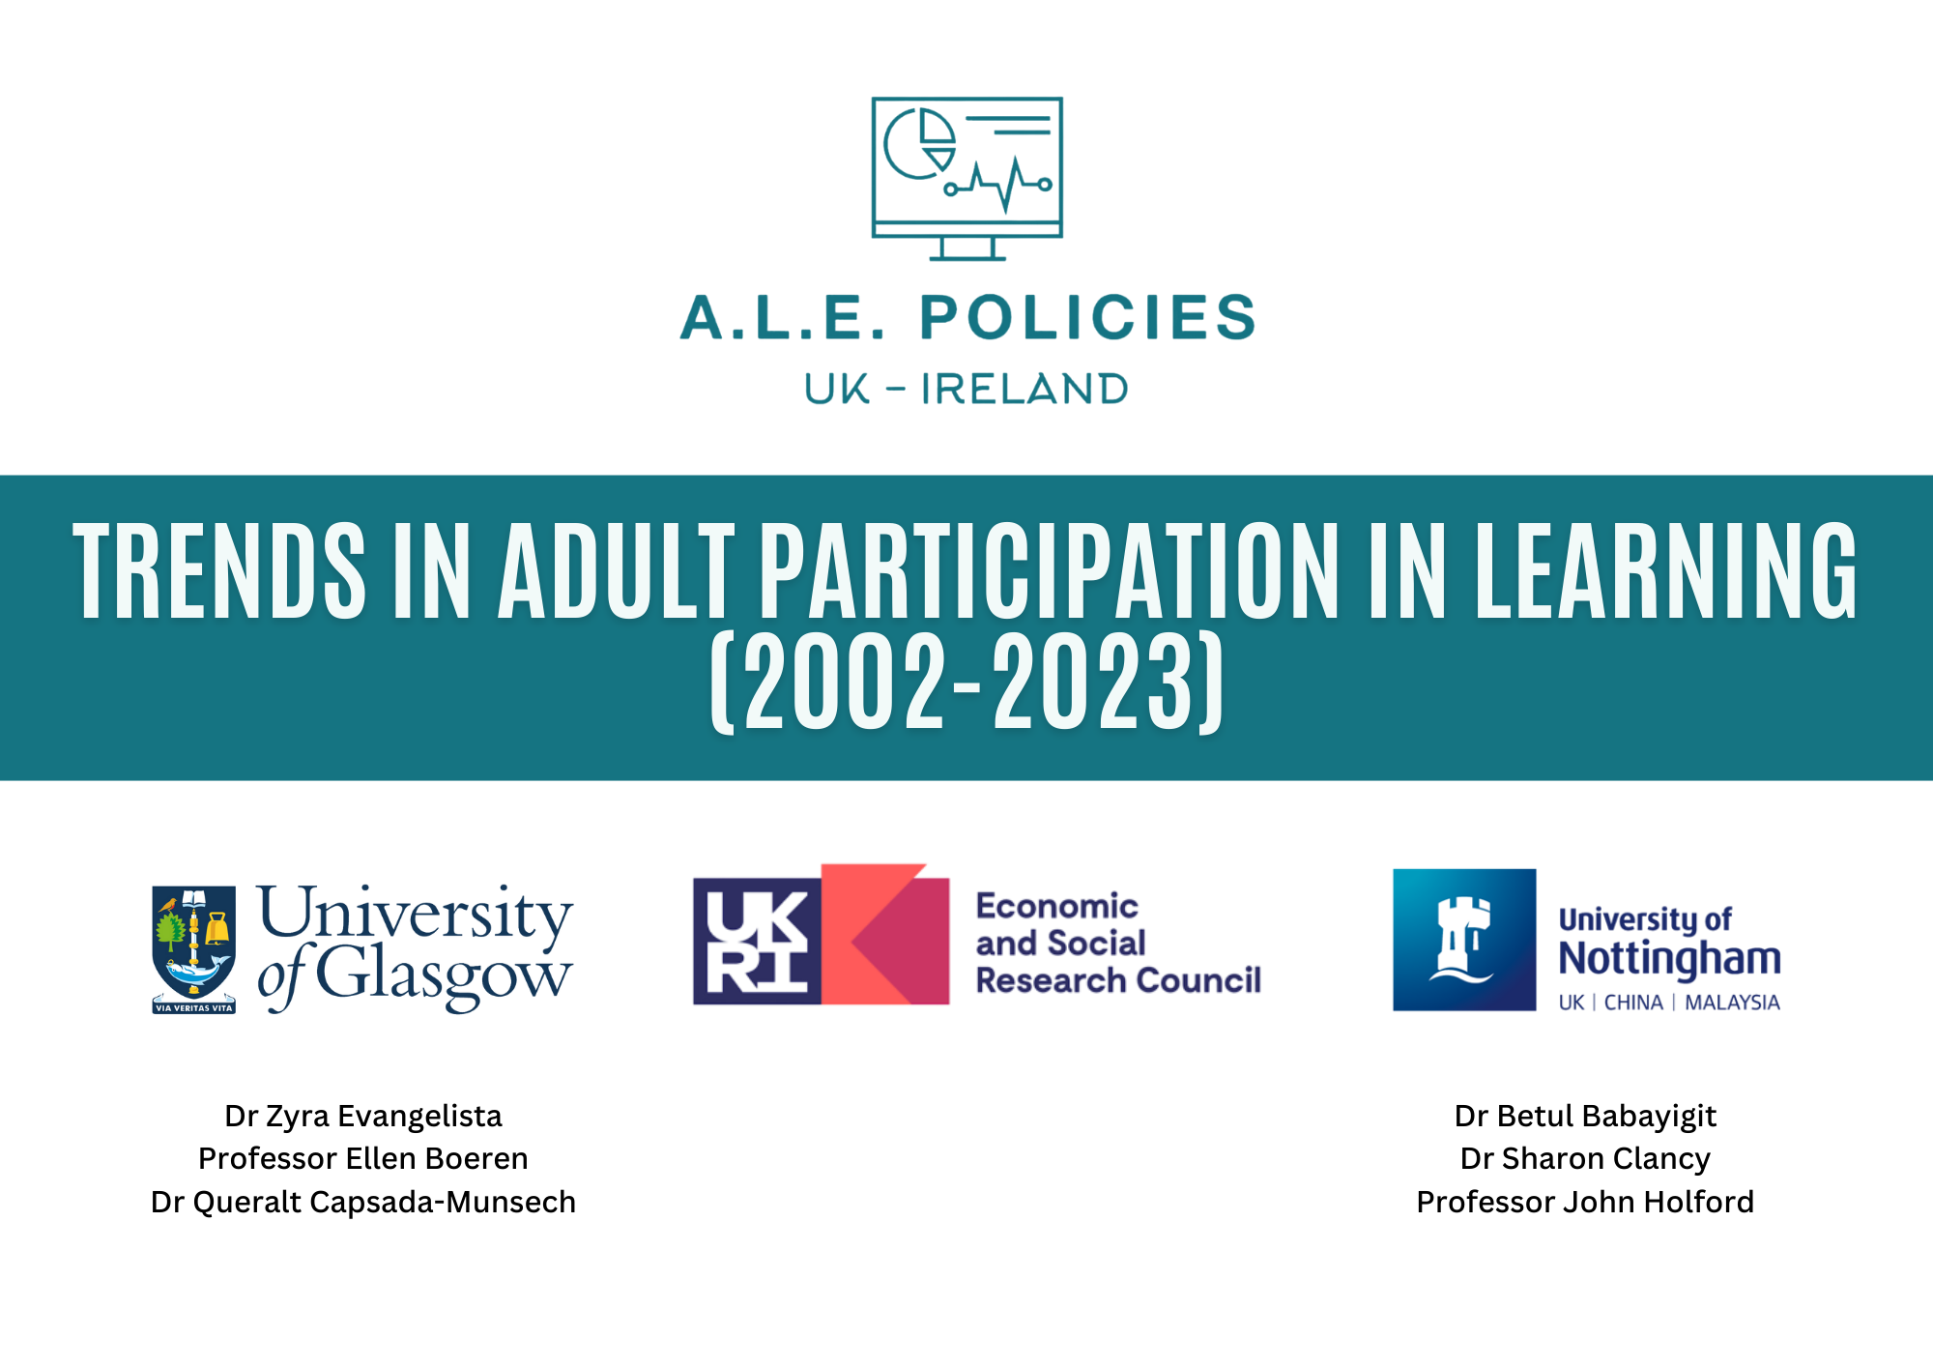

Slide 2
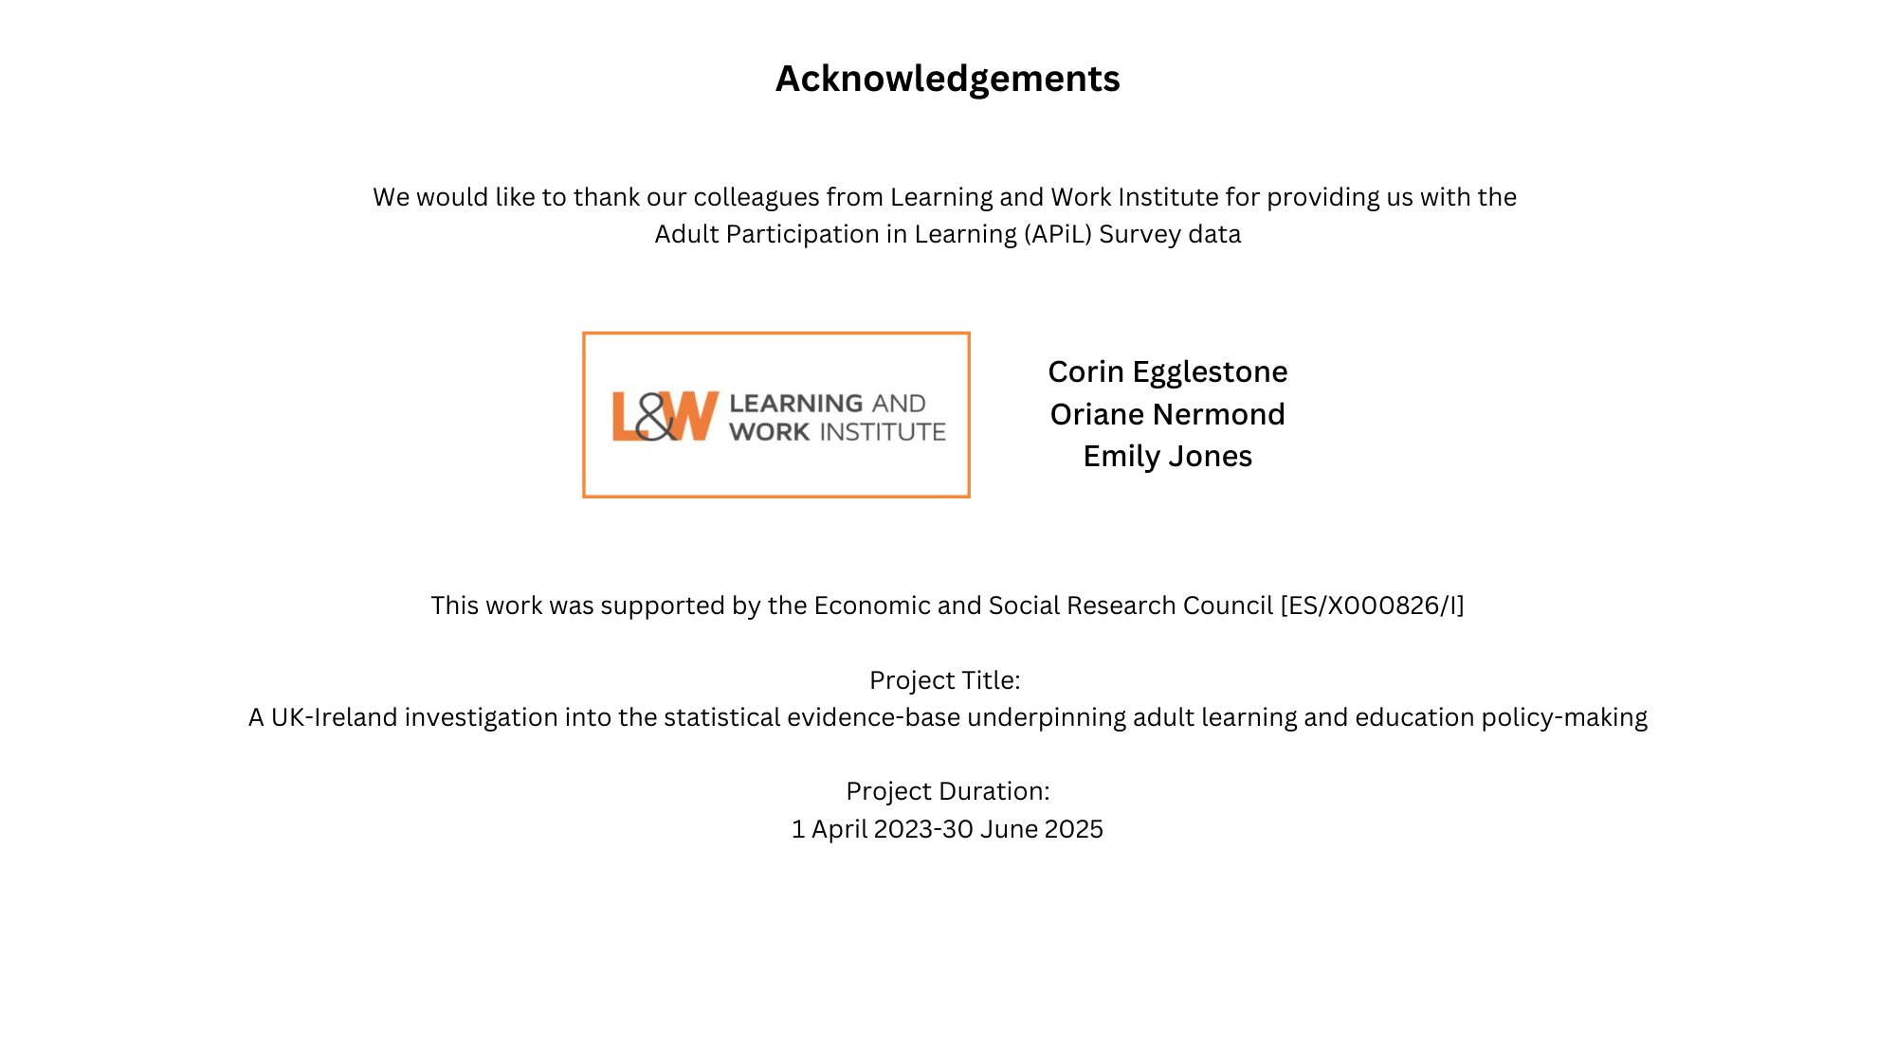

Slide 3

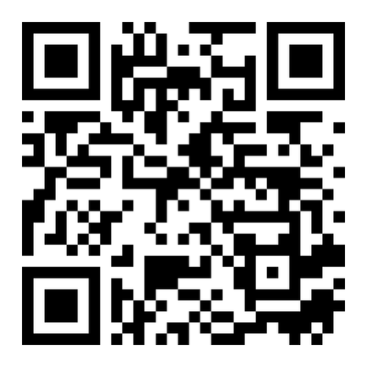
Work package 1
To investigate the (potential lack of) consistency of the current statistical evidence base on ALE across the four countries of the UK and Ireland
Work package 2
To identify factors that contributed to the decline in ALE participation against economic, societal and political changes in the past 25 years
Work package 3
To investigate convergence and divergence of ALE discourses between the devolved administrations of the UK and Ireland with a specific focus on the role of evidence-based policy making through documentary analyses and in-depth interviews
PROJECT OVERVIEW
https://adultlearningpolicies.co.uk/

Slide 4
WEBINAR OVERVIEW
APiL Survey background
Learning and Work Institute
APiL Survey (2002-2023) trends
University of Glasgow & University of Nottingham
Q&A

Slide 5
KEY QUESTIONS
What do we know about how adults’ participation in learning and education has changed over the past 20 years?
Years 2002-2023 (except 2016, 2020)
What patterns of participation do we observe in the adult population?
Adults aged 25-64 in the UK

Slide 6

Adult Participation in Learning Survey
Emily Jones, Deputy Director
Emily.Jones@learningandwork.org.uk

Slide 7

Learning and Work Institute is an independent policy and research organisation focused on lifelong learning and better work.
Our vision is for a fair and prosperous society where learning and work enable everyone to realise their potential.
We research what works, influence policy and develop new ideas to improve practice.

Slide 8
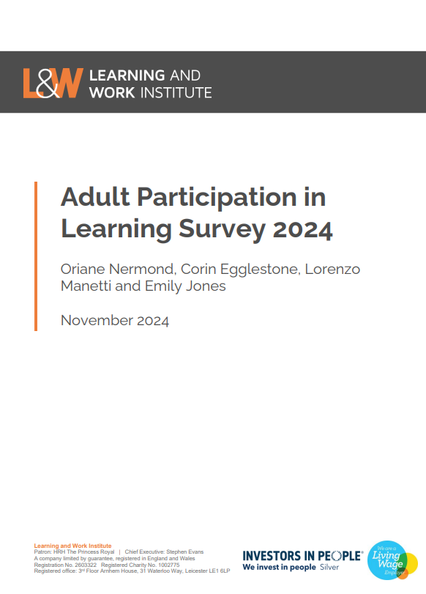
Adult Participation in Learning Survey
Representative sample of approximately 5,000 adults in the UK
Longest running and most frequently occurring study of learning across the UK
Survey conducted by a market research company as part of an online omnibus survey
Definition of learning and core questions have remained the same since the survey started
Used by government, policy organisations and universities, and attracts national and trade press coverage

Slide 9
Definition of learning
  “Learning can mean practising, studying or reading about something. It can also mean being taught, instructed or coached. This is so you can develop skills, knowledge, abilities or understanding of something.
  Learning can also be called education or training. You can do it regularly (each day or month) or you can do it for a short period of time. It can be full time, or part time, done at home, at work, or in another place like a college.
  Learning does not have to lead to a qualification. We are interested in any learning you have done, whether or not it was finished.”

Slide 10

Information collected
Topics:
  Motivations for learning
  Benefits of learning
  Barriers to learn and challenges while learning
  How do people learn
  Future likelihood of learning
Breakdown:
  Social grade
  Age
  Employment status
  Educational attainment
  Gender
  Geography (regional level)

Slide 11
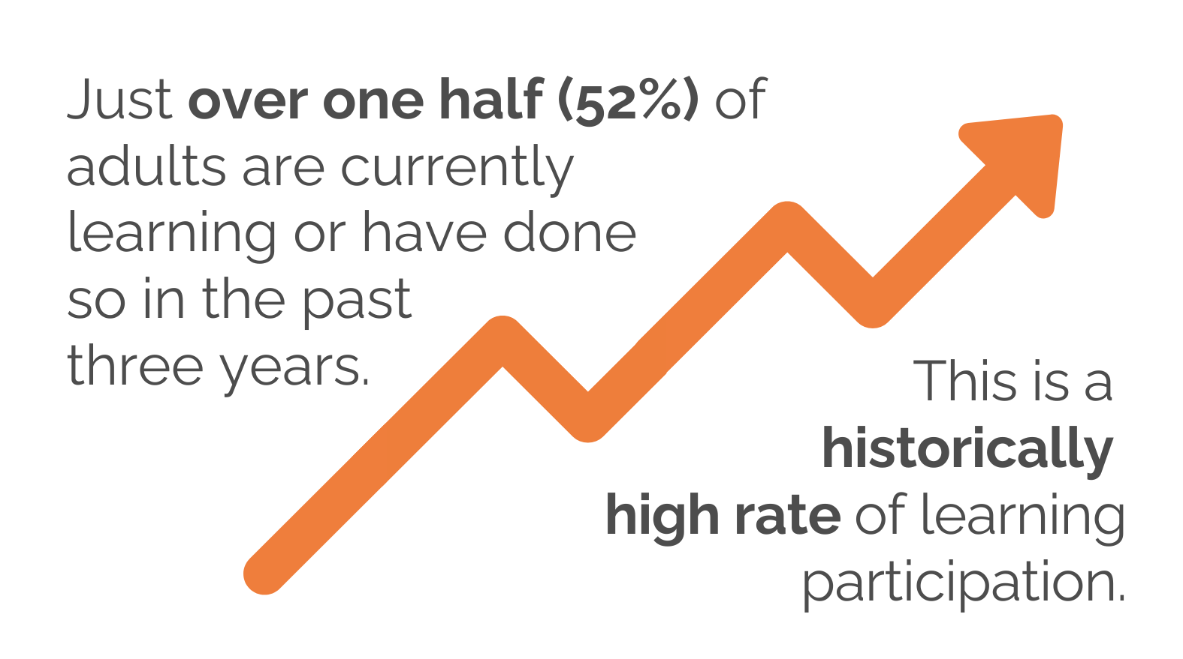
Participation in learning, 1996-2024

Slide 12
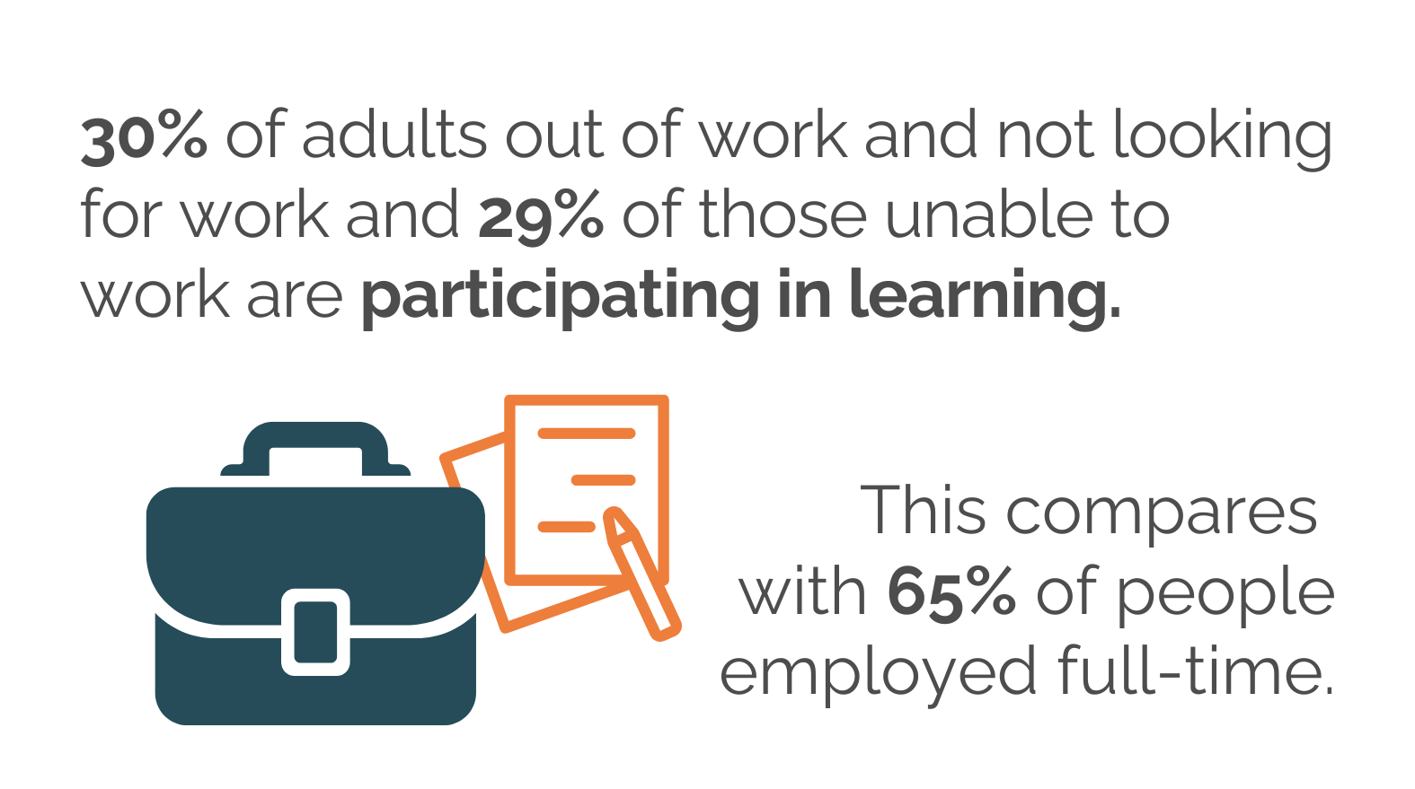
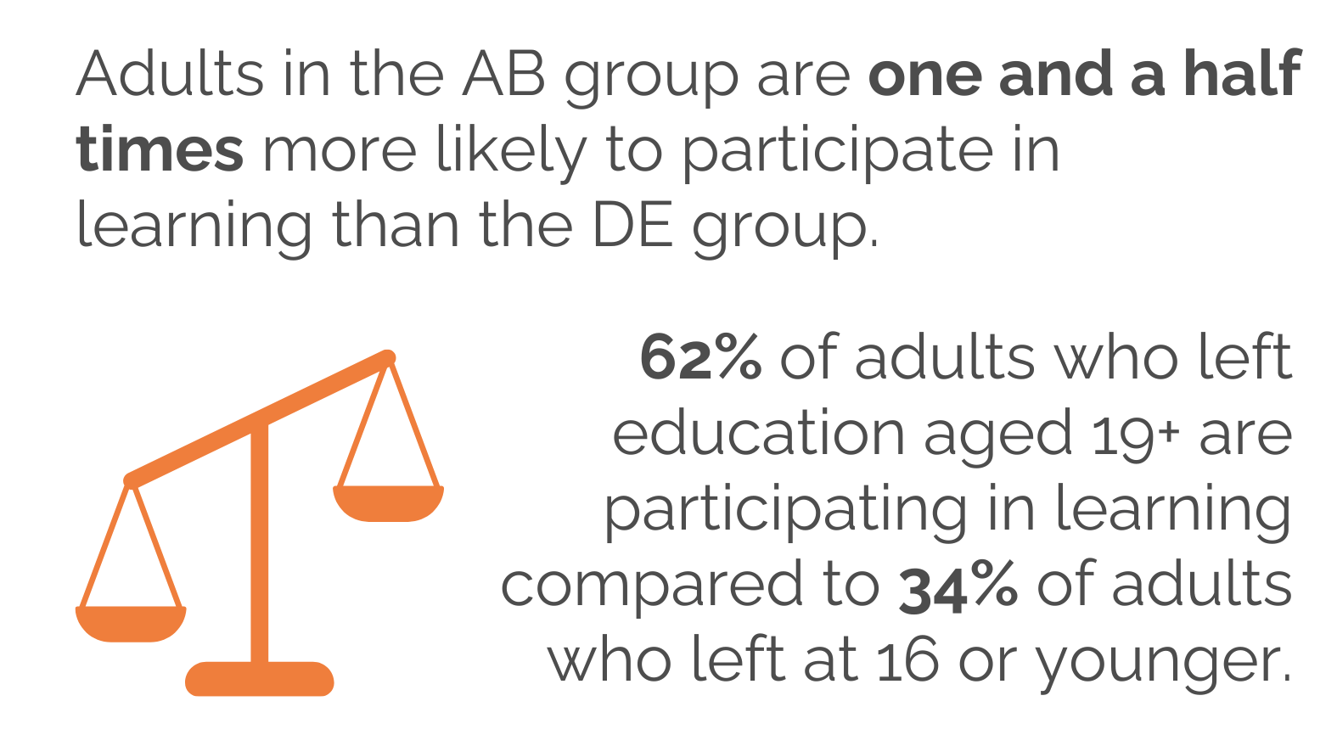
Persistent inequalities
Employment status
Social grade

Slide 13
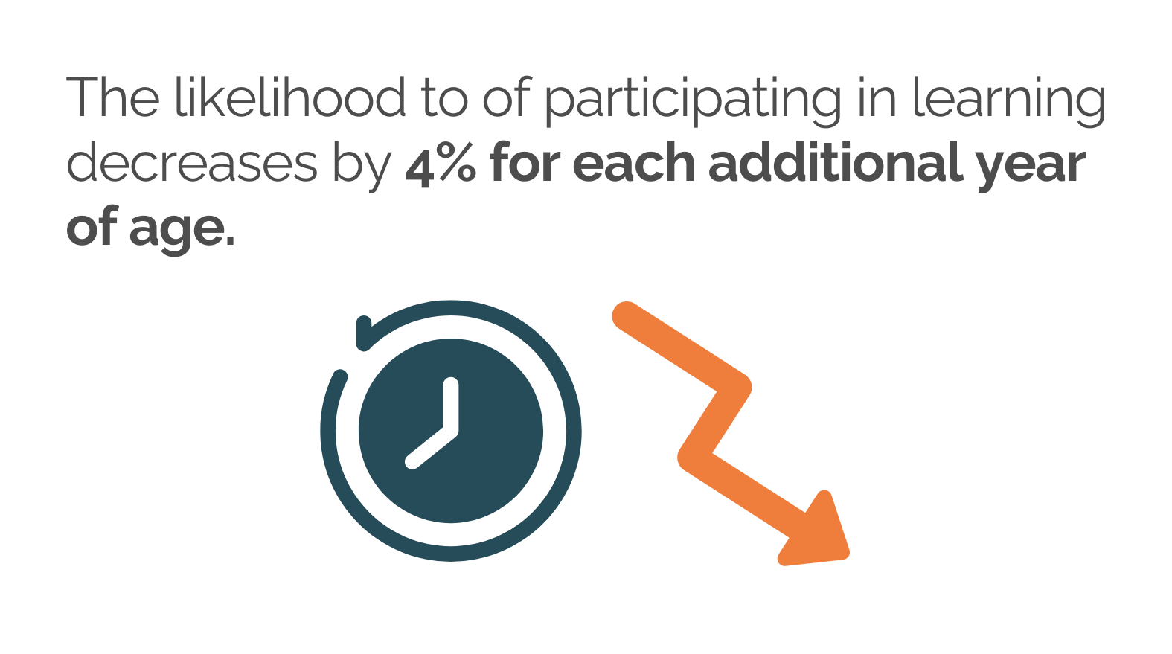
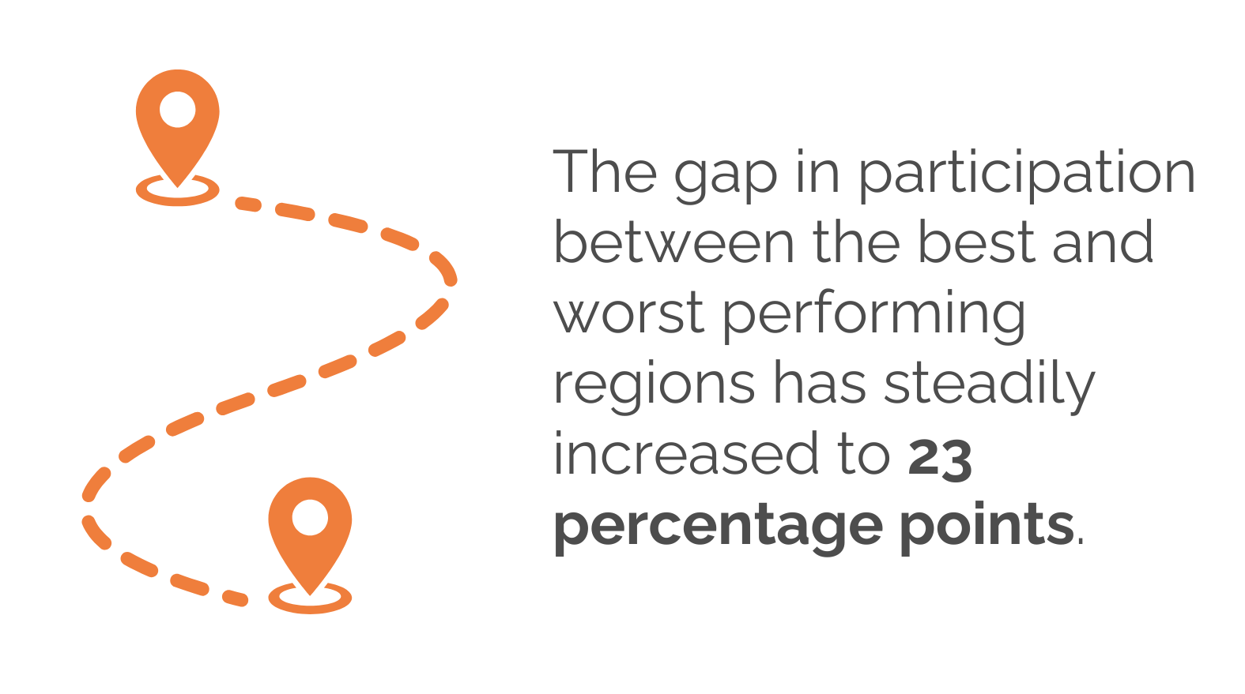
Persistent inequalities
Age
Regional differences

Slide 14

Conclusion
  We know that learning can have positive impacts on people’s life.
  Survey provides insights on how adults can be motivated to learn and the barriers that need addressing.
  We will be publishing the results of the 2025 survey in November.
  Get in touch: emily.jones@learningandwork.org.uk

Slide 15
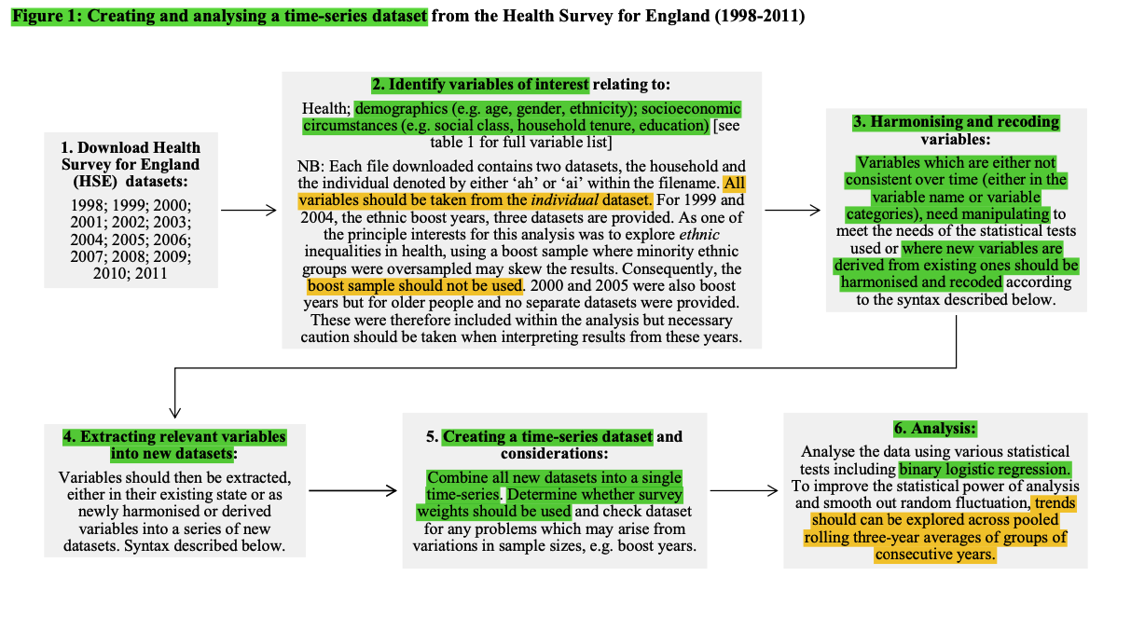
Data harmonisation of the APiL Survey (2002-2023) based on Darlington et al. (2014)
2. Identify variables of interest
Gender
Age category
Age left FT education
FT employment
Social grade
Participation
Future learning
Nation/Government region
Other variables to be added (e.g. motivations, barriers)
3. Harmonising and recoding variables
Recoded variables using SPSS (e.g. ‘recode’, ‘compute’ functions)
(see Excel recoding sheet and SPSS syntax for details)
1. Download APiL datasets
2002-2023
(except 2016, 2020)
5. Creating a pooled dataset and considerations
Computed a master weight based on 5500 sample size:
5500 divided by ‘year sample size’ multiplied by ‘year weight’
6. Analysis
Analysed the data using logistic regression
(see SPSS syntax for details)
4. Extracting relevant variables into new dataset
Recoded variables in each dataset were extracted and merged into a new dataset
(see SPSS syntax for details)

Slide 16
HARMONISED DATASET 2002-2023:
17 DEMOGRAPHIC VARIABLES
Exact age
Nation/Region (Scotland, England, etc.)
Ethnicity binary (White, Minority ethnic)
Ethnicity category
(Mixed, Asian, Black, etc.)
Gender
(women, men)
Age category
(25-34, 35-44, etc.)
Age left FT education
(below 21, 21+)
Full-time employment
(yes, no)
Social grade
(AB, C1, C2, DE)
Area
(urban, rural)
Work status
(full-time, part-time, retired, etc.)
Chief income earner in household
(yes, no)
Principal shopper in household
(yes, no)
Tenure
(mortgage, rent private, etc.)
Internet access (yes, no)
Marital status (married, single, etc.)
Children
(yes, no)

Slide 17
HARMONISED DATASET 2002-2023: 9 ALE VARIABLES
VARIABLE NAME | QUESTION | RESPONSE OPTIONS
participation_xyz | Which of the following statements most applies to you? | I am currently doing some learning activity now I have done some learning activity in the last 3 years I have studied/learnt but it was over 3 years ago I have not studied/learnt since I left FT education Don’t know
learn_uptake | How likely are you to take up any learning in the next 3 years? | no (unlikely) yes (likely)
motive_xyz | Which of the following best describes the reasons you started this learning? | To get a new job, Not really my choice, etc.
motive2 | Did you decide to do this for leisure/personal interest or is it for your work/career reasons? | For leisure/personal interest, For my work/career
benefit_xyz | Can you identify any changes or benefits that have happened as a result of your learning? | I have got/expect to get a new job, My self-confidence has improved, etc.
challenge_xyz | What has made your learning difficult? | Cost/money, Childcare, Nothing, etc.
provision_xyz | How did you do this learning? | Through a university, On the job, etc.
payfee_xyz | Who pays/paid for this learning? | There was no fee to be paid, I paid the fee directly, etc.
barrier_xyz (non-ALE participants) | What would you say are the main things preventing you from taking part in learning? | Cost/money, Childcare, Nothing is preventing me, etc.

Slide 18
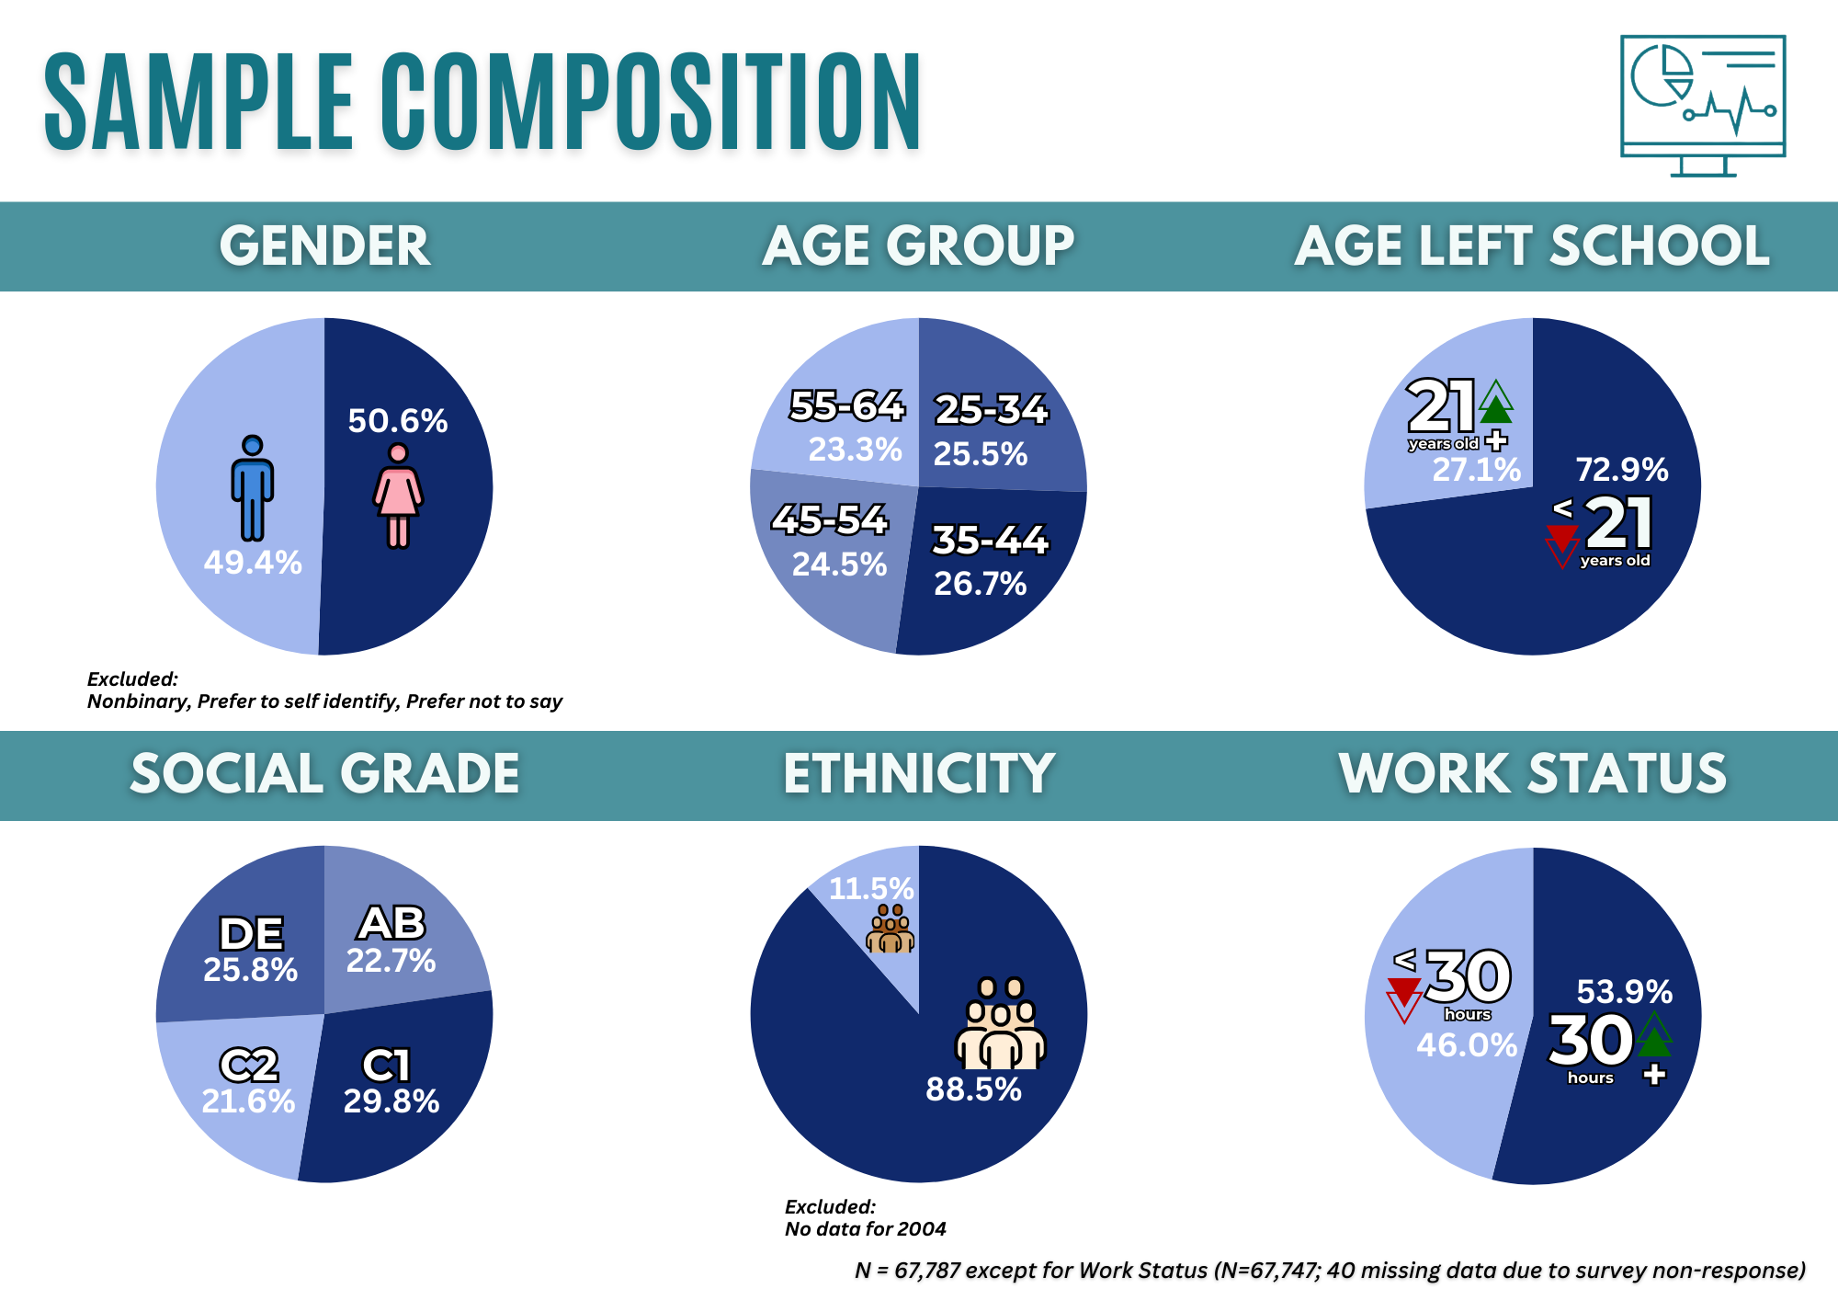

Slide 19
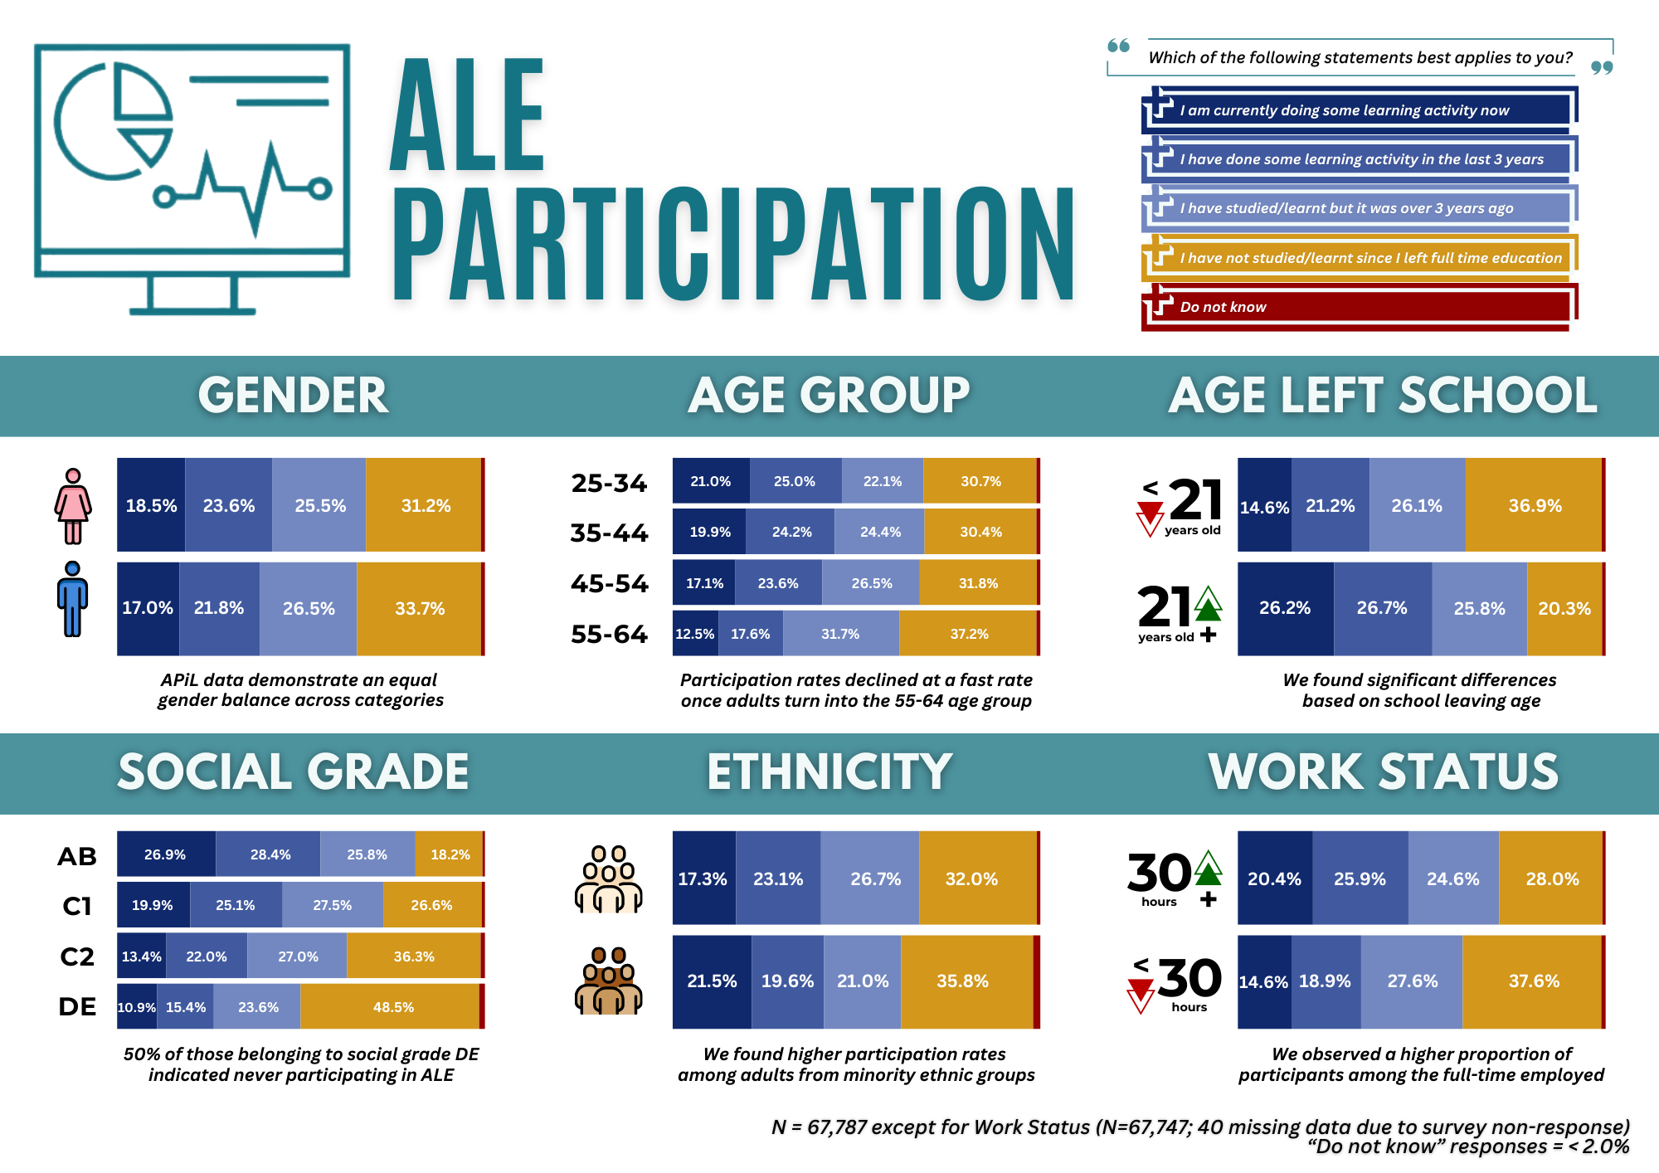
WHO PARTICIPATED IN ADULT LEARNING AND EDUCATION BETWEEN 2002-2003?

Slide 20
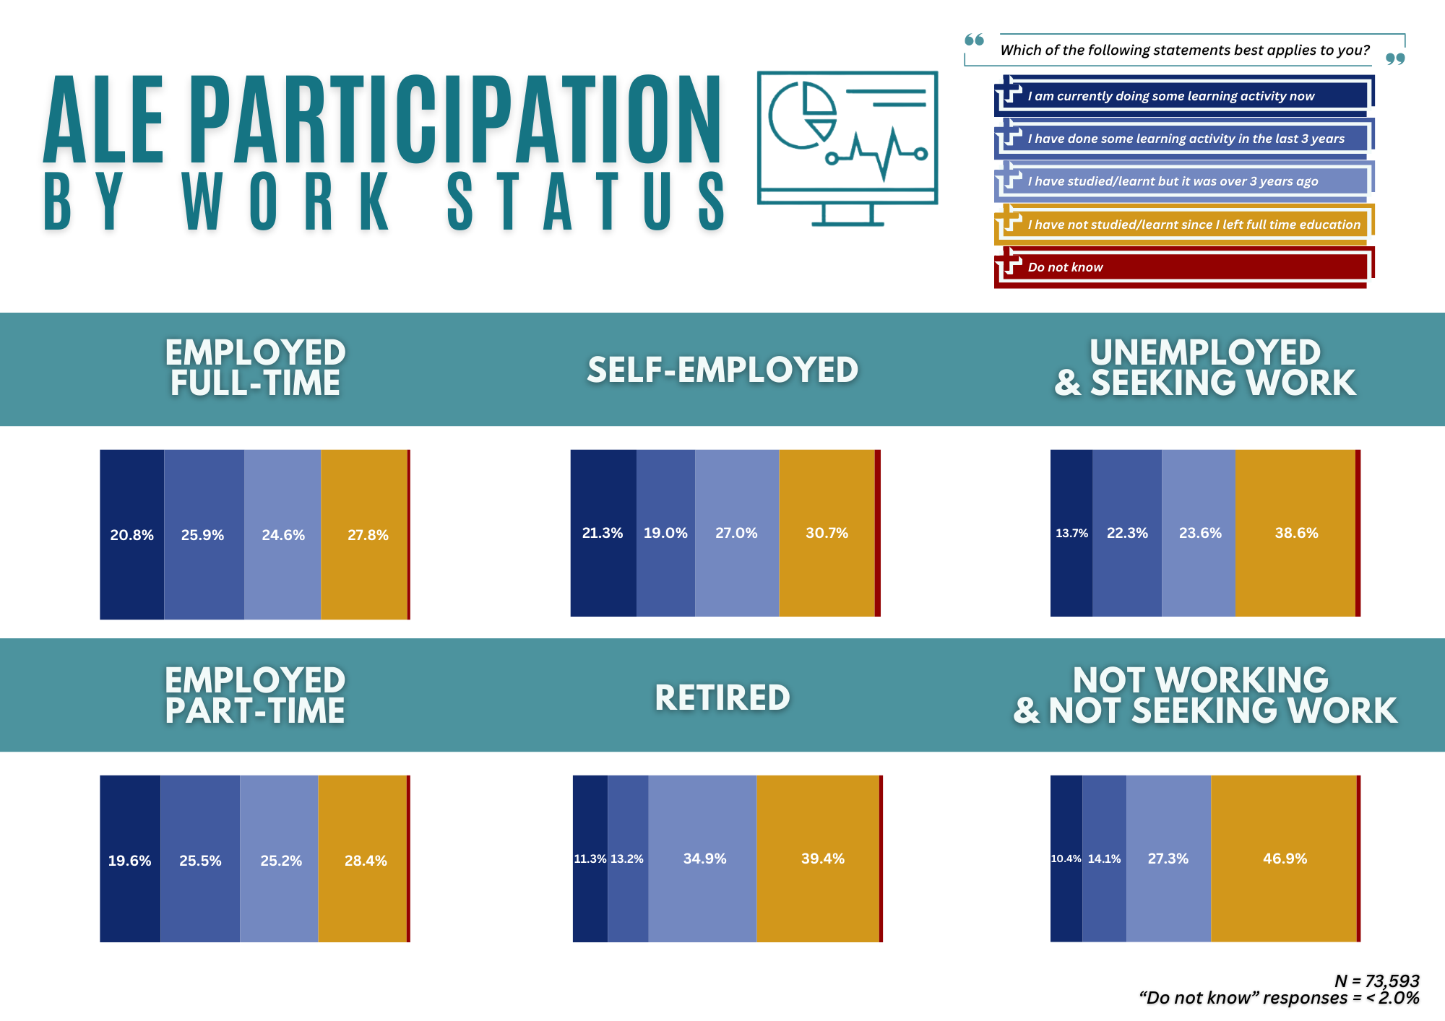
WHO PARTICIPATED IN ADULT LEARNING AND EDUCATION BETWEEN 2002-2003?

Slide 21
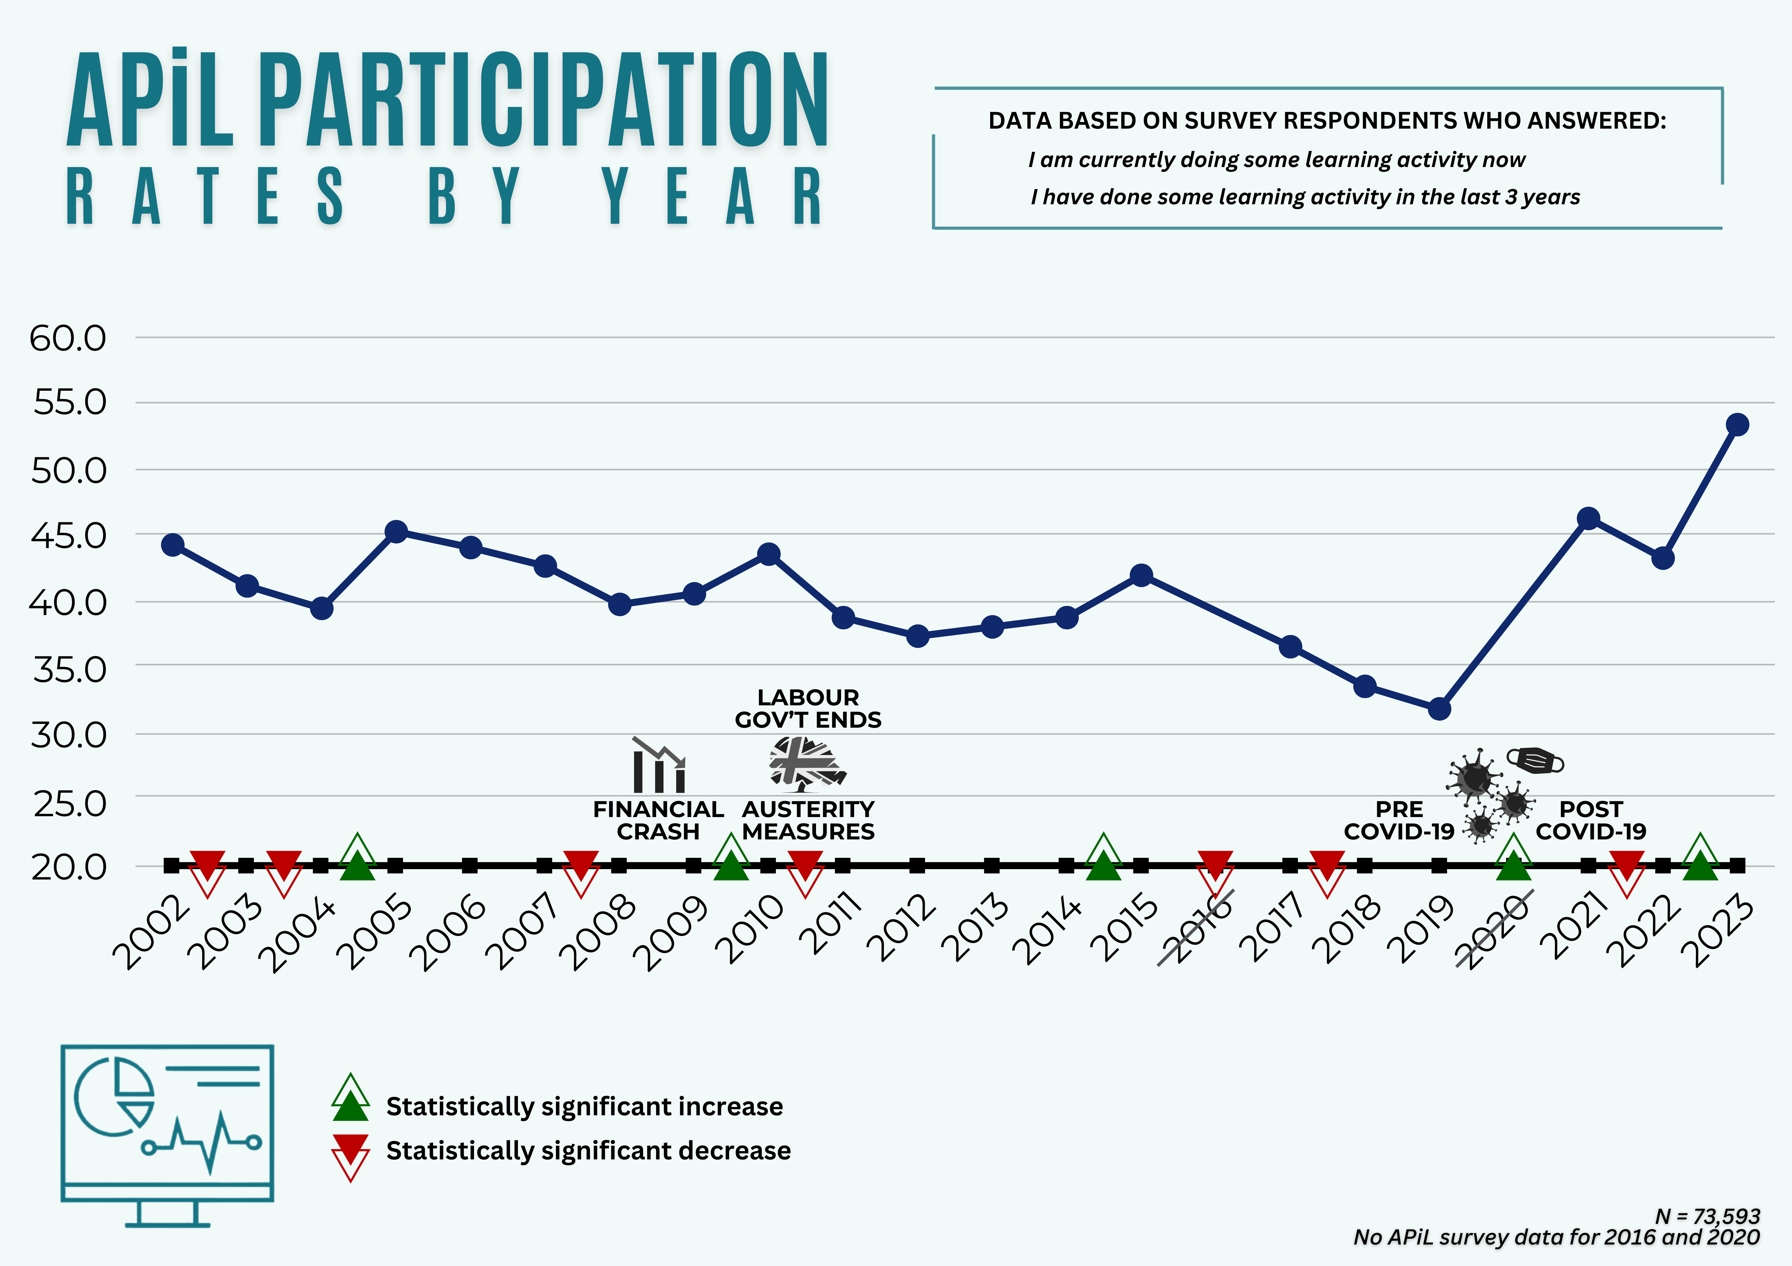
HOW HAVE APiL PARTICIPATION RATES VARIED BY YEAR?

Slide 22
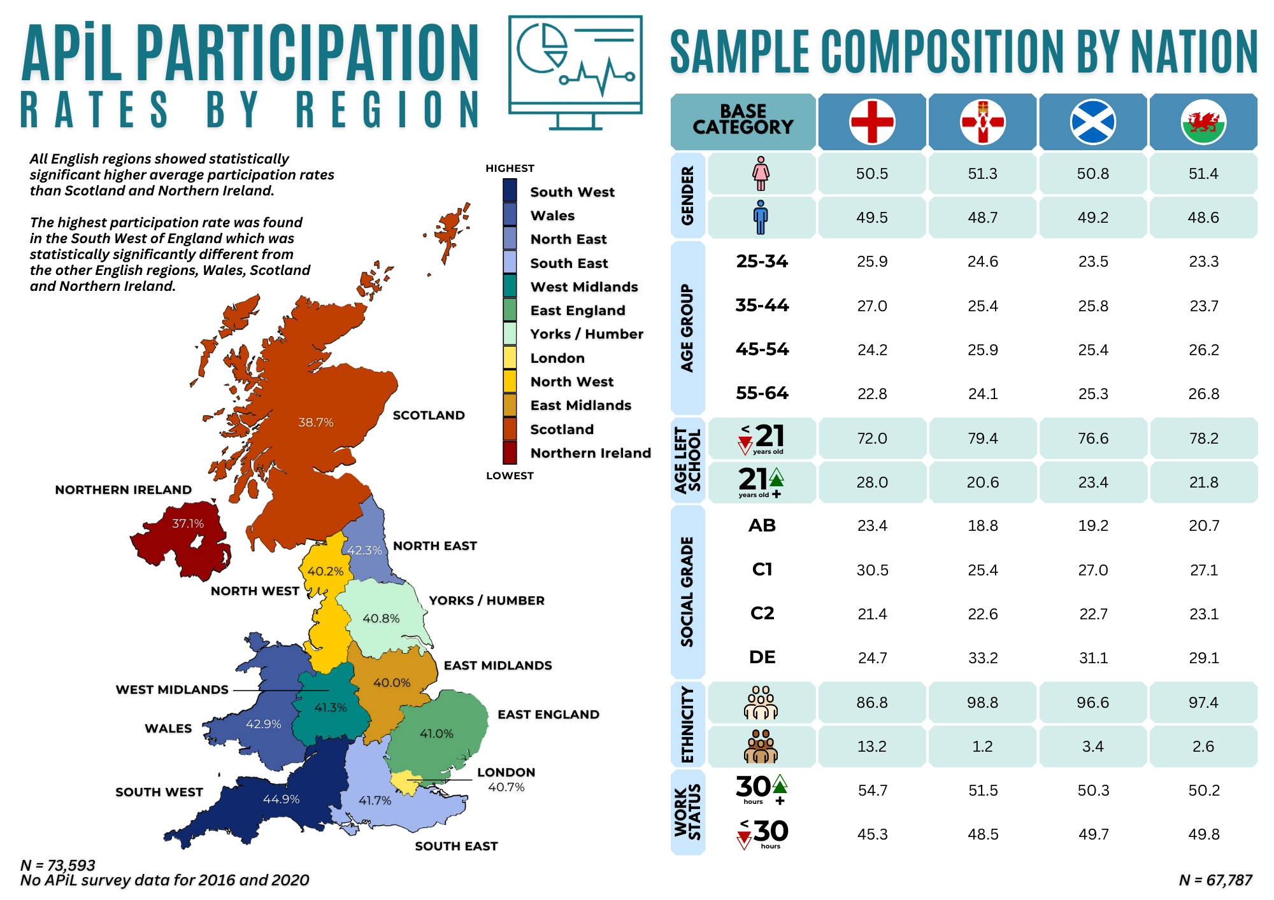
HOW HAVE APiL PARTICIPATION RATES VARIED BY REGION?

Slide 23
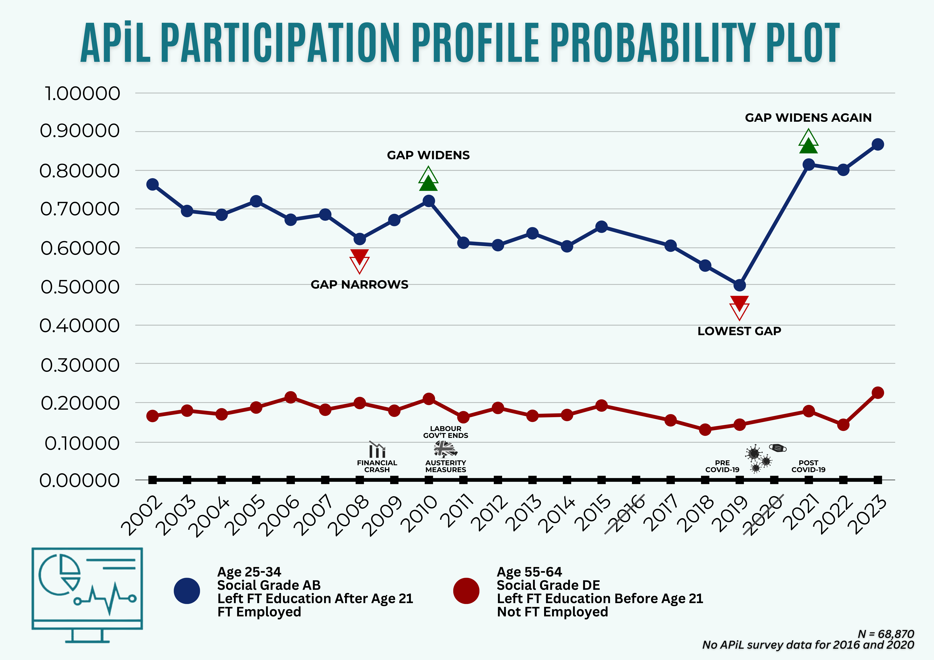
WHO TENDS TO PARTICIPATE IN ALE?

Slide 24
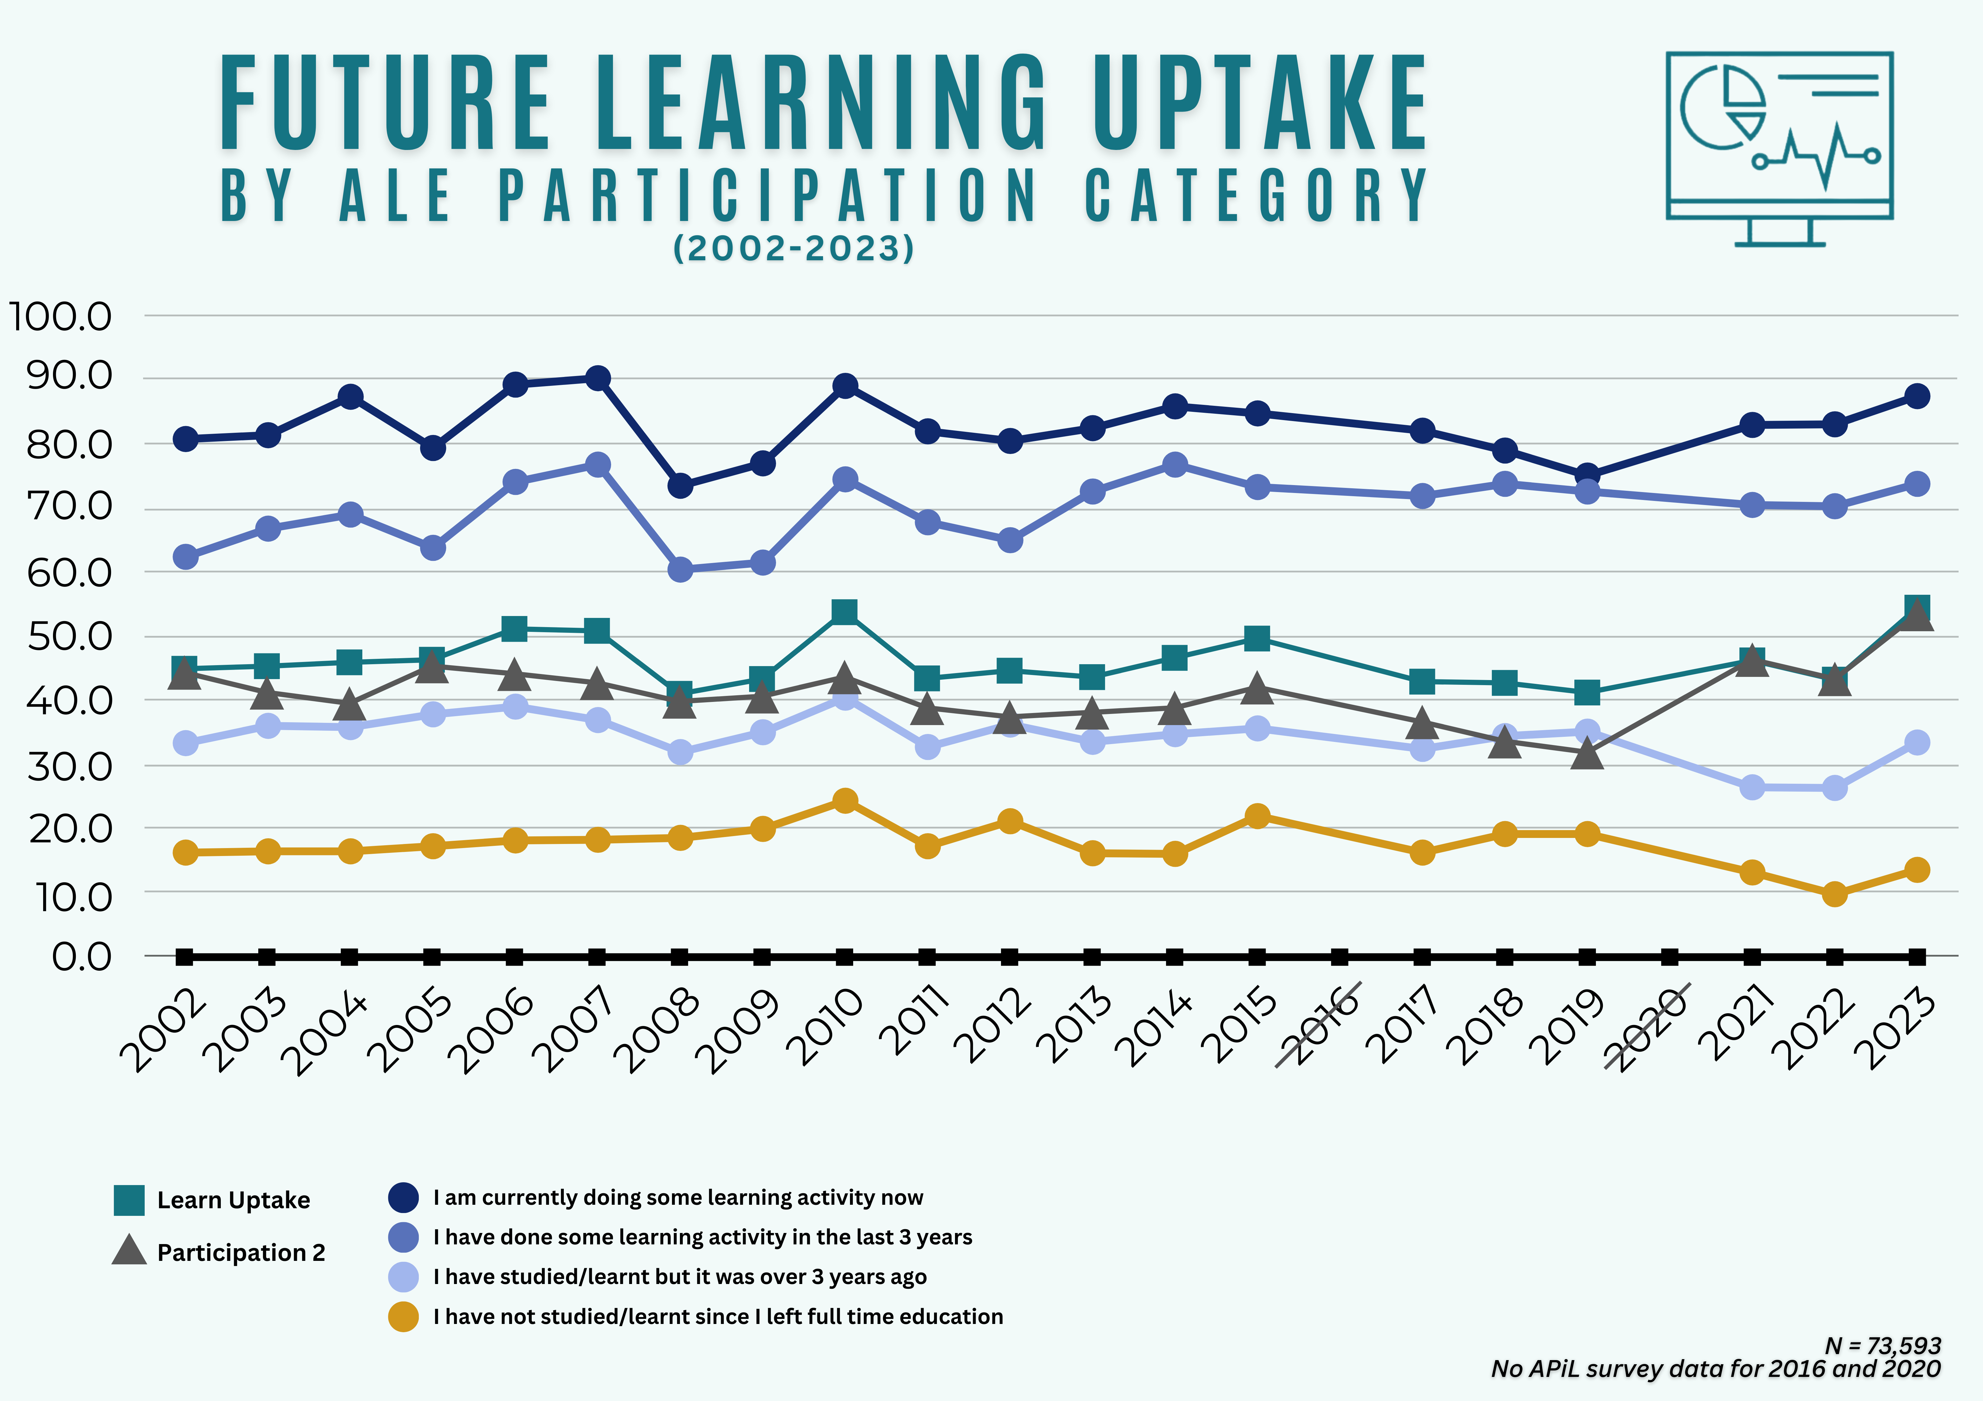
WHAT ARE THE TRENDS IN FUTURE PARTICIPATION IN ALE?

Slide 25
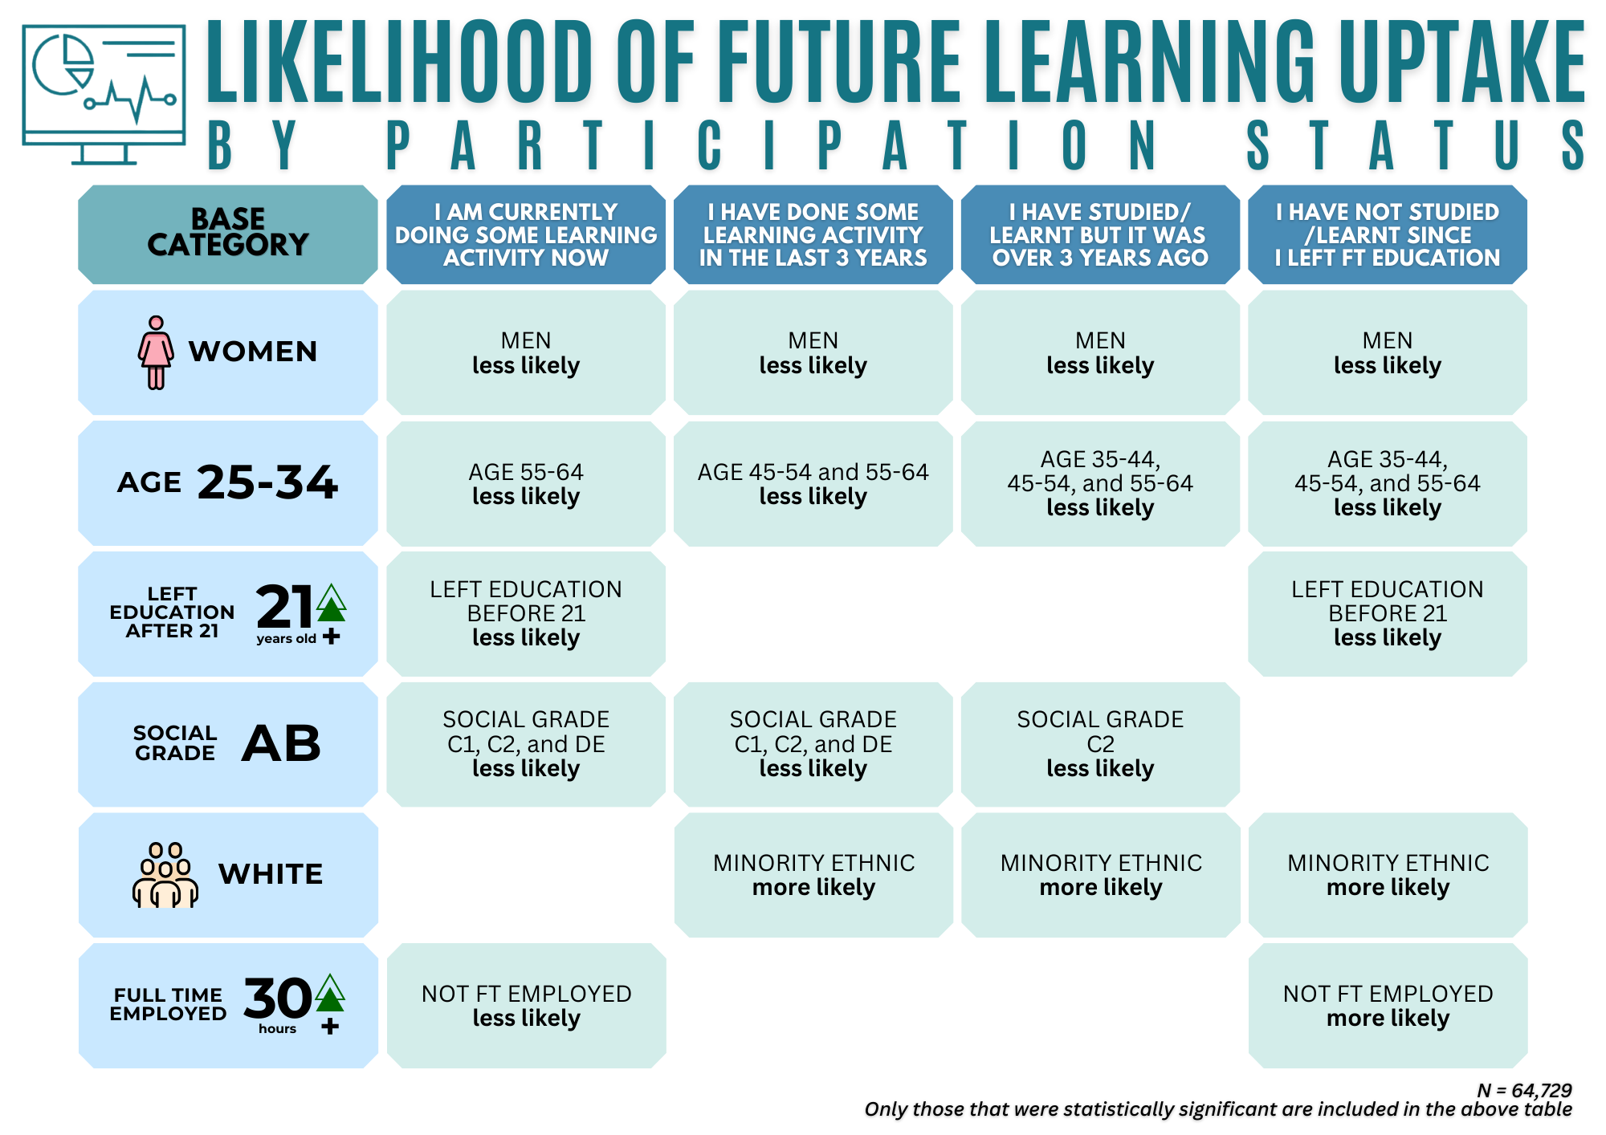
WHO IS MORE LIKELY TO INDICATE FUTURE INTENTIONS TO PARTICIPATE IN ALE?

Slide 26
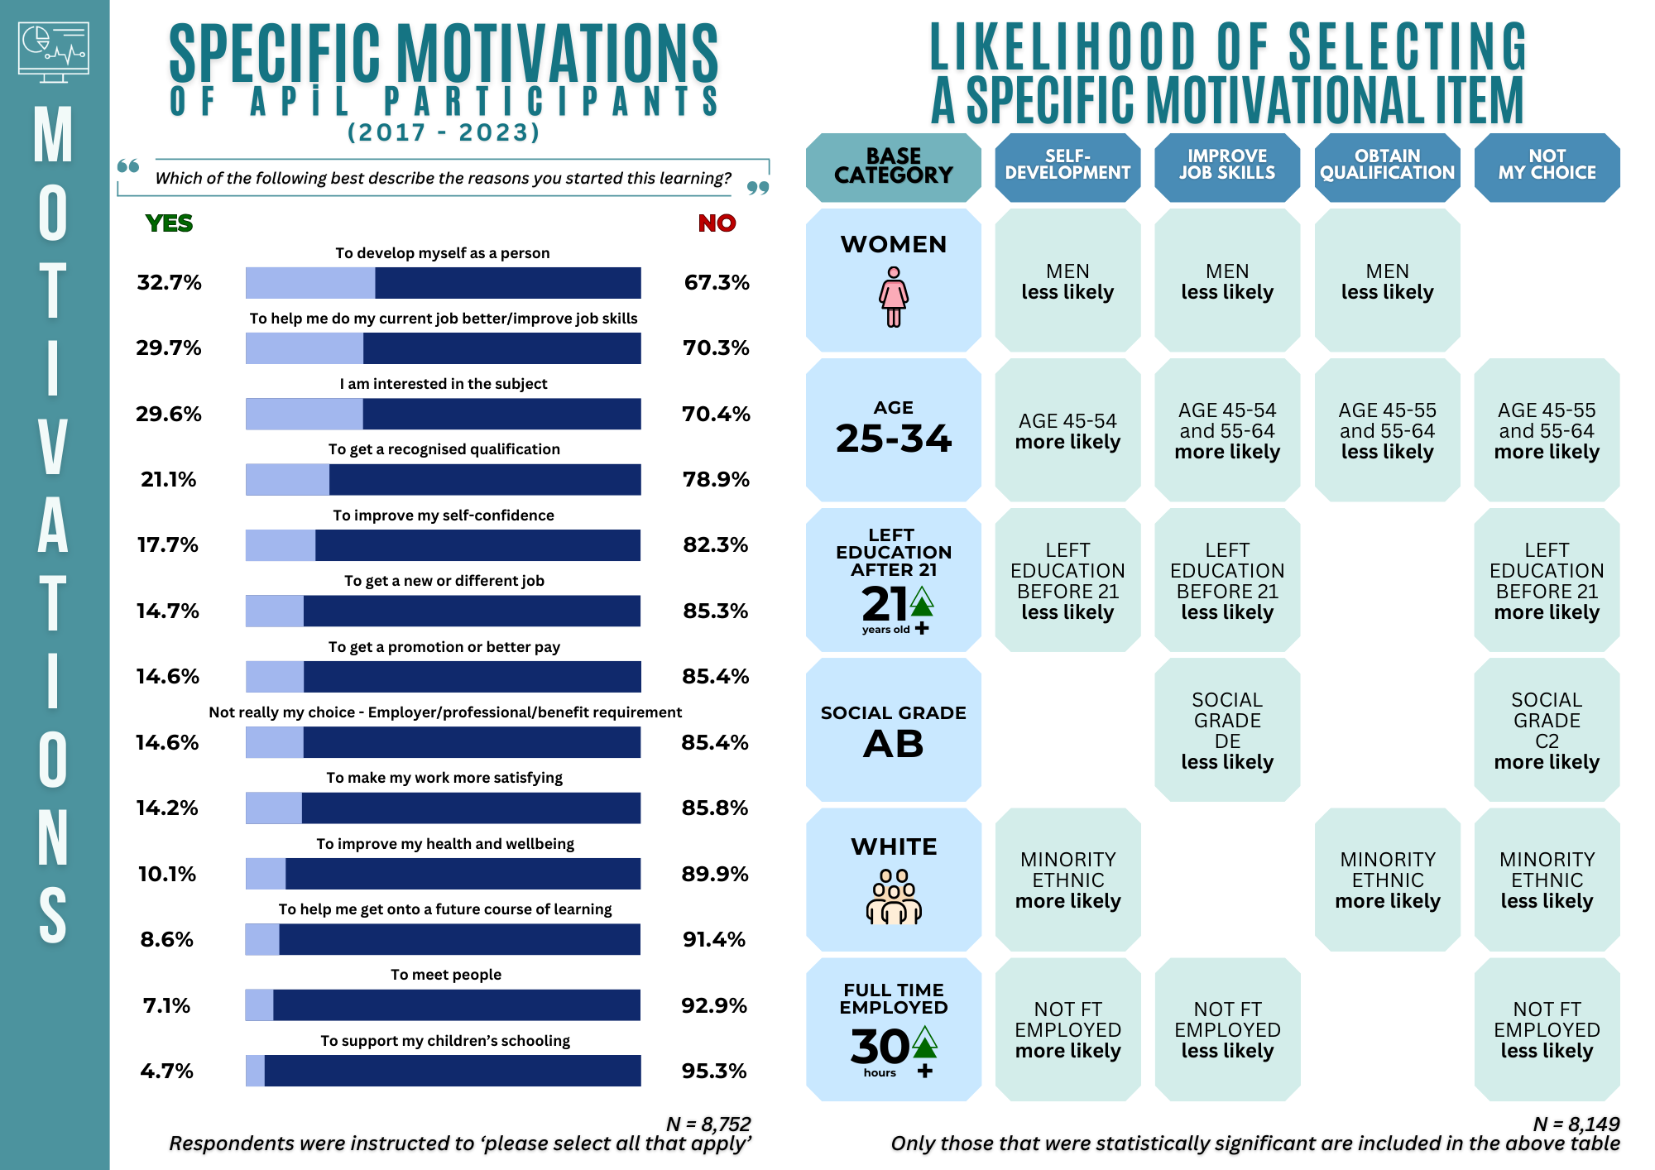
ALE PARTICIPANTS: WHAT MOTIVATES ADULTS TO LEARN?

Slide 27
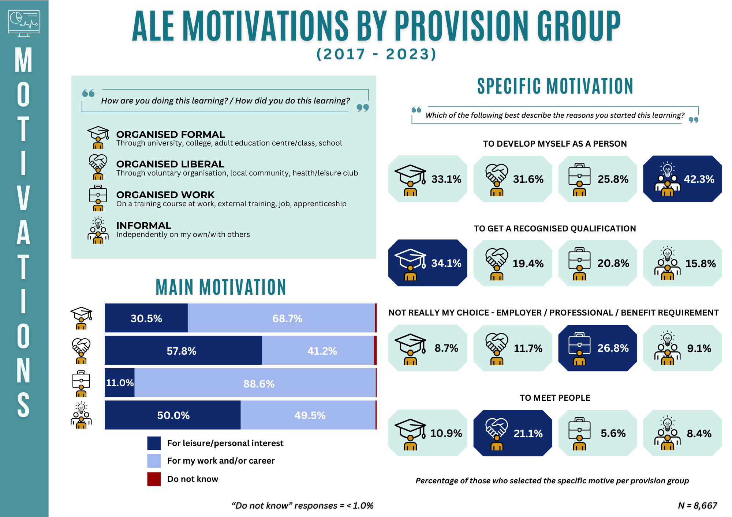
ALE PARTICIPANTS: WHAT MOTIVATES ADULTS TO LEARN?

Slide 28
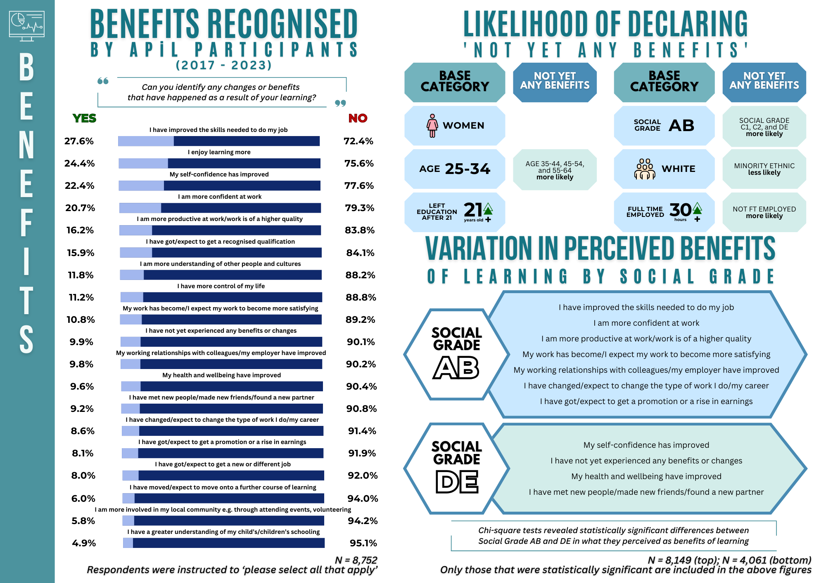
ALE PARTICIPANTS: WHAT BENEFITS DO ADULTS EXPECT FROM LEARNING?

Slide 29
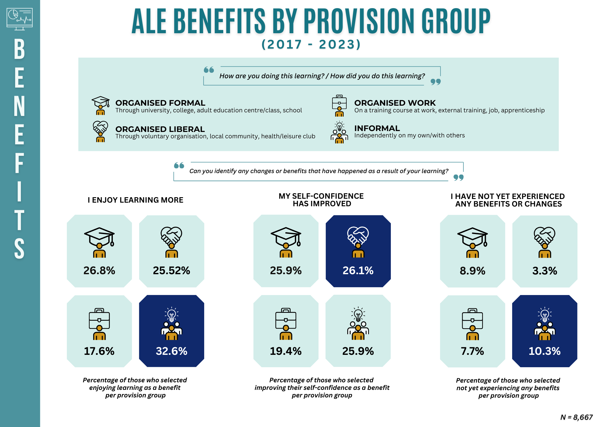
ALE PARTICIPANTS: WHAT BENEFITS DO ADULTS EXPECT FROM LEARNING?

Slide 30
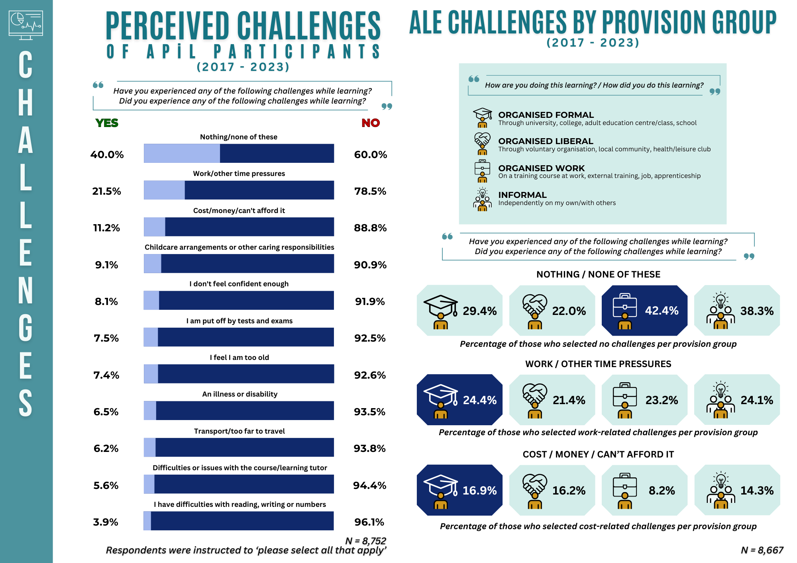
ALE PARTICIPANTS: WHAT CHALLENGES DO ADULTS ENCOUNTER IN THEIR LEARNING?

Slide 31
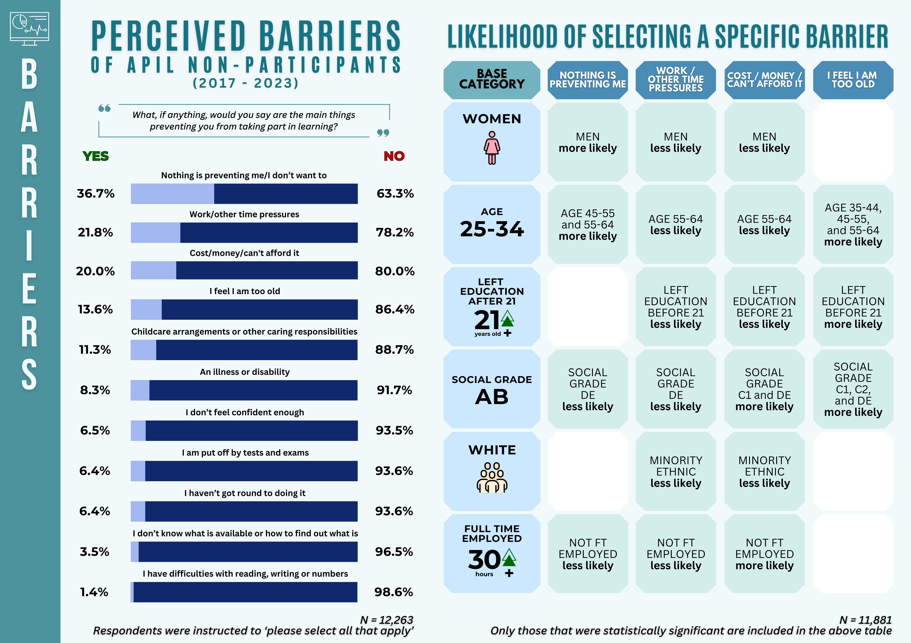
ALE NON-PARTICIPANTS:
WHAT BARRIERS DO THEY ENCOUNTER THAT PREVENT THEIR LEARNING?

Slide 32
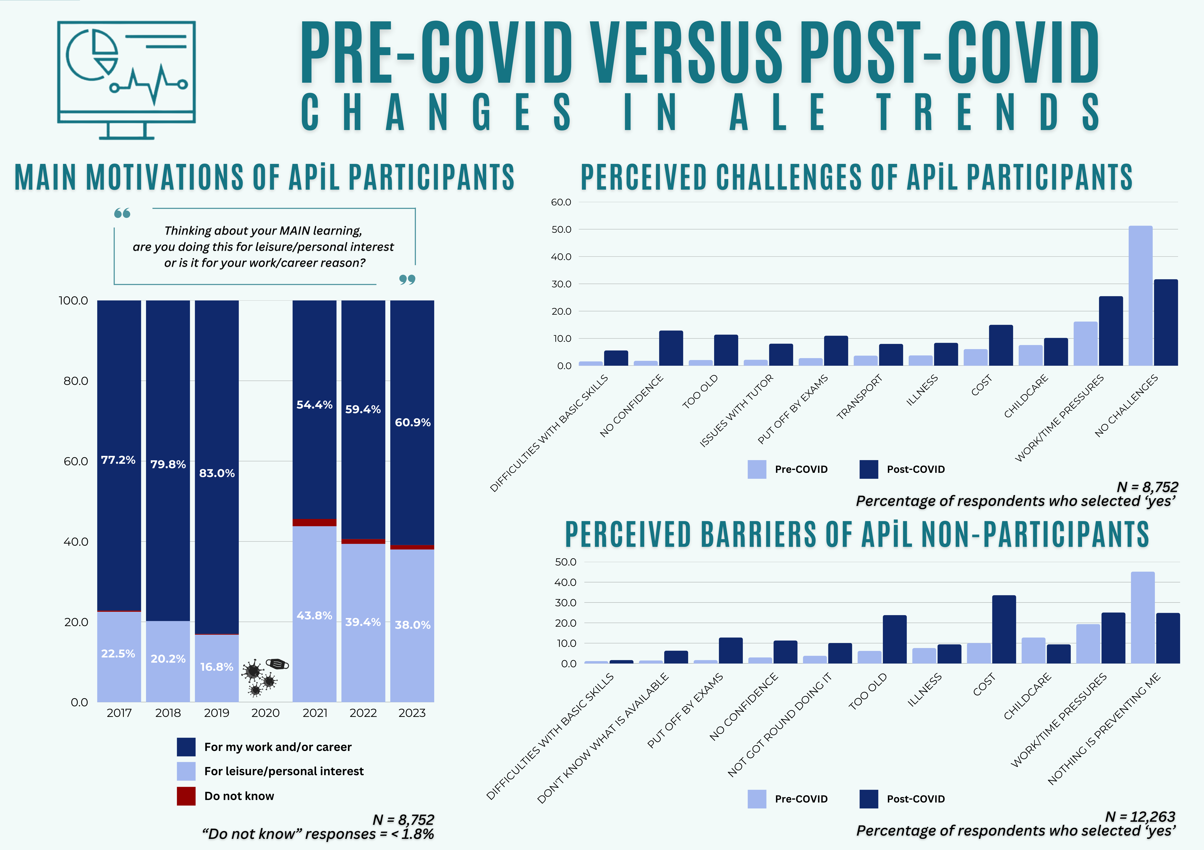
WHAT ARE THE TRENDS BEFORE & AFTER COVID-19?

Slide 33
WHAT ABOUT TRENDS IN APiL PARTICIPATION & MACRO-LEVEL INDICATORS?

Slide 34
Socio-demographic determinants of participation were generally in line with existing literature
Actual participation and future learning intentions declined by age and social grade
Gendered patterns remain in terms of financial situation and work-life balance
Class differences were clearly visible in the data and were more powerful than differences in relation to gender and ethnicity
Those in full-time employment participated more but they were also more likely to indicate that their participation was involuntary
Younger adults who finished their initial education at or after age 21, belonging to the highest social grade AB, and are in full-time employment had the highest probability of taking part in adult learning and education
KEY INSIGHTS:
ALE trends based on APiL Survey

Slide 35
Inequalities in participation were lowest in times where participation rates were also at their lowest
The decline in participation rates occurred because of lower engagement among those with the strongest probabilities to participate
The decline co-occurred with a lower expenditure on adult learning, lower trade union membership numbers and a rise in zero-hour contracts and precarious work
It should also be noted that the decline coincides with austerity measures, lower employer investment in training, and a ‘policy churn’ that disproportionately benefits younger adults following traditional learning pathways
KEY INSIGHTS:
ALE trends based on APiL Survey

Slide 36
Strongest predictor of future participation/learning intentions is previous participation
This underlines the cumulative effect of participation
Those who participated at the time of the survey or in the three years before the data collection point were much more likely to express an interest than non-participants
KEY INSIGHTS:
ALE trends based on APiL Survey

Slide 37
More longitudinal research
A more rigorous tracking of participants over time will help to reveal benefits of their ALE participation more accurately
Alternative approaches to data collection
Combine quantitative & qualitative methods to go beyond ‘listing’ of barriers, benefits, motivations to delve deeper into nuances
Tracking whether involuntary participation leads to satisfactory learning outcomes
Evaluate initiatives such as Devolved Skills Funding and Lifelong Learning Entitlement
Maximise usage of existing databases (e.g. Labour Force Survey) to provide more robust insights on the regional variation in ALE participation over time
RESEARCH RECOMMENDATIONS

Slide 38
Address cost and time barriers/challenges
Address stubborn inequalities in ALE participation
Implement adequate finance mechanisms to lower cost barriers
Blend engagement in ALE as part of adults’ work-life balance
Tackle unequal chances early in the life cycle
Continue efforts to make learning more accessible for all and consistently reach out to those who are underrepresented
Support second chance routes
Incentivise learning throughout life both for work and non-work related reasons
POLICY & PRACTICE RECOMMENDATIONS

Slide 39


Project Website:
https://adultlearningpolicies.co.uk
Scan to read
SPECIAL ISSUE PAPER IN THE INTERNATIONAL JOURNAL OF LIFELONG EDUCATION
https://doi.org/10.1080/02601370.2025.2493798

