Slide 1


Evidence-based policy making in adult learning and education: insights from the ESRC A.L.E. Policies project
Tuesday 24 June 2025
Professor Ellen Boeren
Dr Zyra Evangelista
Dr Queralt Capsada-Munsech
Dr Sharon Clancy
Dr Betul Babayigit
Professor John Holford

Slide 2
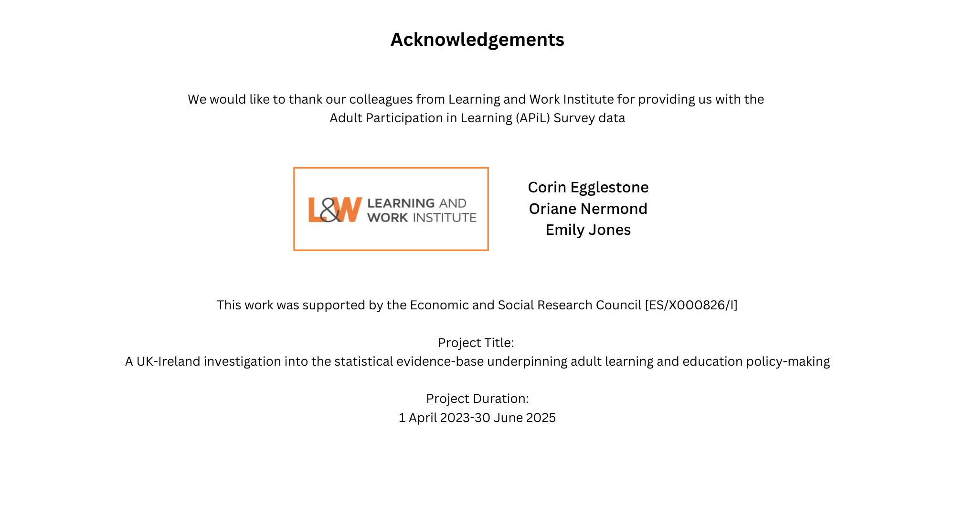

Slide 3
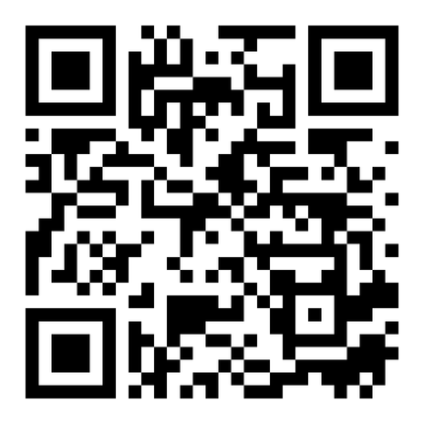
Work package 1
To investigate the (potential lack of) consistency of the current statistical evidence base on ALE across the four countries of the UK and Ireland
Work package 2
To identify factors that contributed to the decline in ALE participation against economic, societal and political changes in the past 25 years
Work package 3
To investigate convergence and divergence of ALE discourses between the devolved administrations of the UK and Ireland with a specific focus on the role of evidence-based policy making through documentary analyses and in-depth interviews
WEBINAR
PROJECT OVERVIEW
WEBINAR
https://adultlearningpolicies.co.uk/

Slide 4
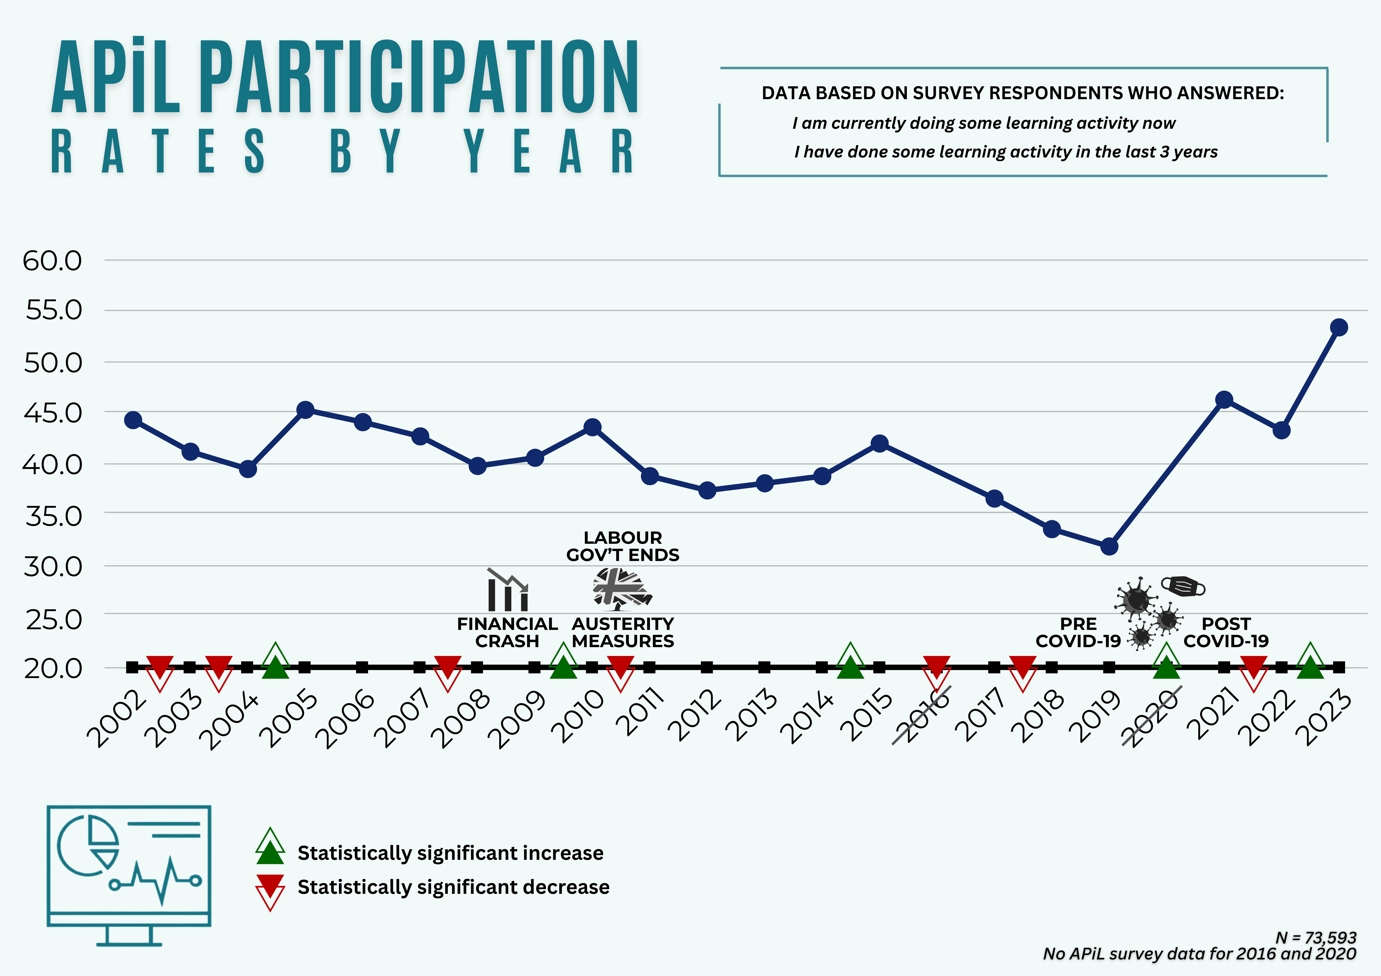
WP2: HOW HAVE APiL PARTICIPATION RATES VARIED BY YEAR?

Slide 5
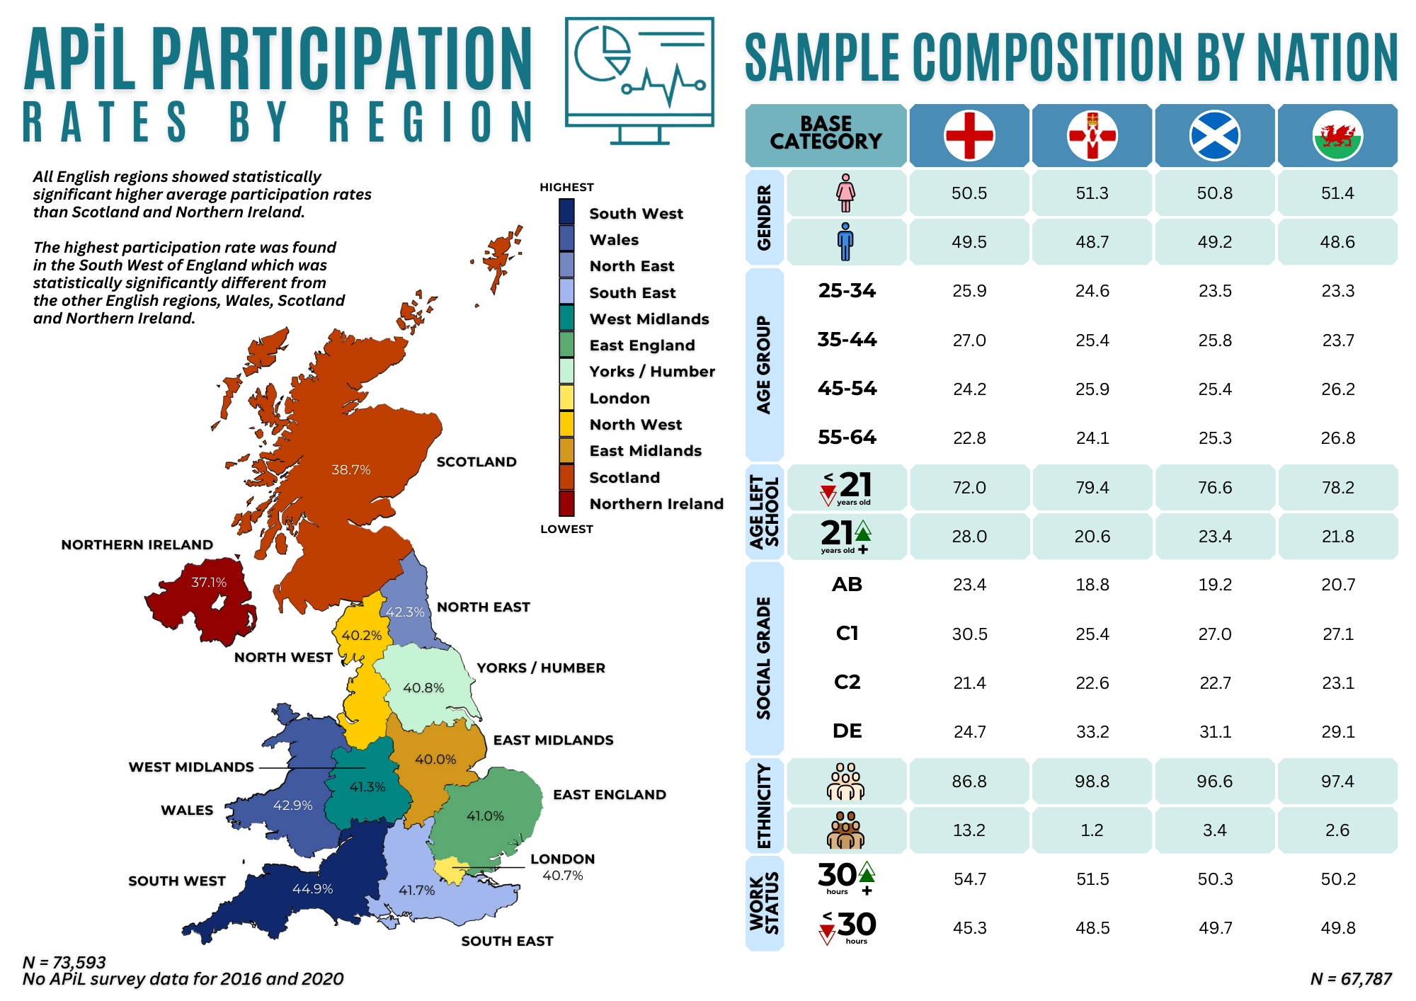
WP2 HOW HAVE APiL PARTICIPATION RATES VARIED BY REGION?

Slide 6
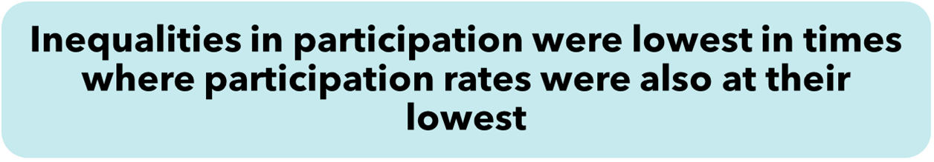
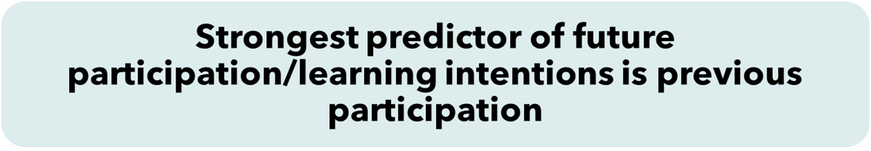
Socio-demographic determinants of participation were generally in line with existing literature
KEY INSIGHTS:
WP2
ALE trends based on APiL Survey

Slide 7



EVIDENCE & A.L.E. POLICY-MAKING

Slide 8
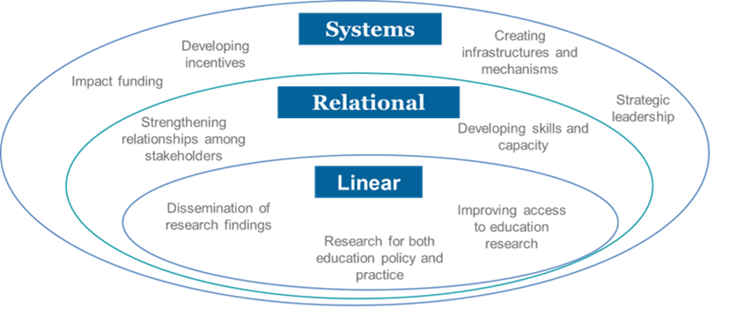
EVIDENCE & A.L.E. POLICY-MAKING
What does the literature say?
Evidence-policy link is non-linear (Bogenschneider & Corbett, 2010).
Policymaking is complex; EBPM often rhetorical (Cairney, 2015).
Research can be ignored or selectively used based on context.
Disconnect especially strong in social sciences (Hammersley, 2002).
FIGURE FROM OECD EVIDENCE SERIES

Slide 9
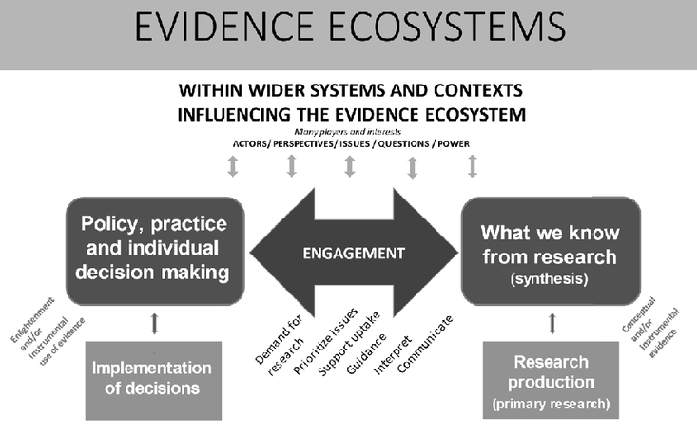
EVIDENCE & A.L.E. POLICY-MAKING
Research Production
Research Use
Role of knowledge brokers
NEED FOR SYSTEMS THINKING
Weight of Evidence
Systematic Reviews
GOUGH ET AL., 2011; GOUGH ET AL., 2022

Slide 10
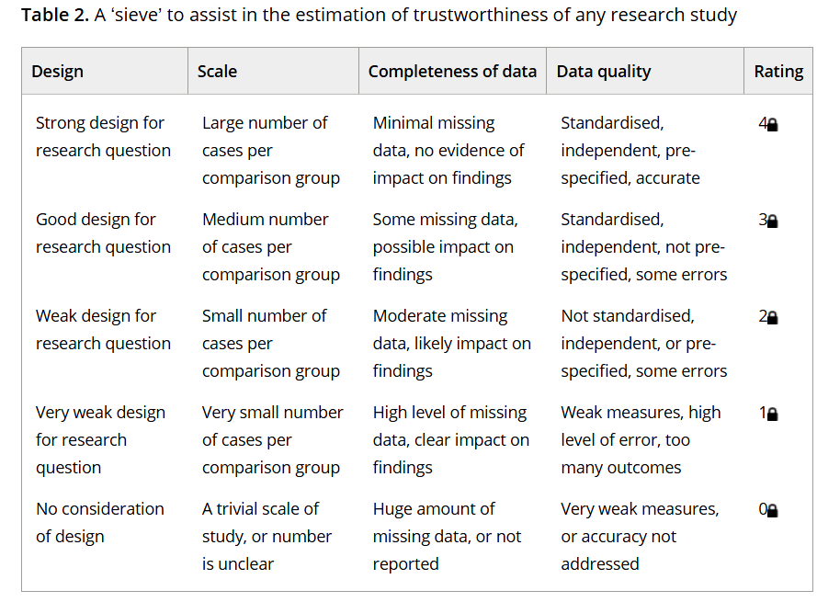
EVIDENCE & A.L.E. POLICY-MAKING
Gorard et al (2020)
Policy should be informed by robust evidence only
Chojnacki et al (2016)
Anecdotal evidence
Descriptive evidence
Correlational evidence
Causal evidence

Slide 11





EVIDENCE & A.L.E. POLICY-MAKING
Bogenschneider & Corbett, 2010
 | POTENTIAL ISSUES
 | Policymaking Process | Unrealistic expectations of research impact; Decisions aren't solely data-driven; Politics is faster-paced than science.; Increasing political polarization.
 | Democratic Complexity | Public decision-making constrains scientific influence; Fragmented power complicates decision-making; Decentralised governance restricts coherence.
 | Science Limitations | Science better suits technical than value-driven issues; Policy questions often exceed what science can answer; Evidence may lack clarity on morally charged issues.
 | Wicked Problems | Lack of consensus on goals, theory, and solutions; Complex, multifaceted societal issues defy simple fixes; ALE is often value-laden and contested.
 | Institutional Mismatch Community Dissonance | Researchers vs. policymakers: different values and norms; Researchers prize ambiguity; policymakers need clarity; Communication gaps across professional cultures.

Slide 12
EVIDENCE & A.L.E. POLICY-MAKING
Bogenschneider & Corbett, 2010
STRONG QUALITY EVIDENCE
versus
HIGH USE OF EVIDENCE
Sounds good in theory but …
WP3 findings

Slide 13
Findings from
INTERNATIONAL ORGANISATIONS
Dr Zyra Evangelista
Findings from POLICYMAKERS
Dr Betul Babayigit
Findings from STAKEHOLDERS
Professor Ellen Boeren
OECD; UNESCO;
European Commission
WP3
Semi-structured interviews
Key informants
Qualitative analysis
Inductive and deductive reasoning
Combination of insights from individual interviewees and pattern spotting
England, Wales, Scotland, NI, ROI
England, Wales, Scotland, NI, ROI

Slide 14
International organisations: PARTICIPANT TABLE
International organisations
Organisation | Pseudonym | Role | Area
EUROPEAN COMMISSION | EC P1 | Policy officer | Adult skills
 | EC P2 | Senior expert | Vocation training and skills policy
 | EC P3 | Data analyst | Educational policy
OECD | OECD P1 | Head | Educational research & innovation
 | OECD P2 | Director | Policy
UNESCO | UNESCO P1 | Director | Policy
 | UNESCO P2 | Consultant | Policy
 | UNESCO P3 | Head | Monitoring
 | UNESCO P4 | Director | Adult education

Slide 15
Do they use evidence?
YES, but…
What evidence do they use?
‘MIXED BAG’ of sources and quality
How do they use it?
Produce a picture of ADULT LEARNING LANDSCAPE to inform and/or justify policies
International organisations
(EUROPEAN COMMISSION, OECD, UNESCO)

Slide 16
Recognised by interviewees BUT evidence availability, quality, usage are not always optimal and can be problematic
IMPORTANCE OF EVIDENCE-BASED POLICYMAKING
International organisations
(EUROPEAN COMMISSION, OECD, UNESCO)

Slide 17
“I think evidence and data are very important to make informed policy decisions, so they’re a crucial part for decision making at the European Commission…”
– EC P1
”…after analysing everything…every recommendation is based on one finding…So it’s research based for designing and evidence-based for recommendations….
There is a move towards more evidence based adult education policy, at least a kind of technocratic approach, which is more now developed…"
– UNESCO P3
International organisations
(EUROPEAN COMMISSION, OECD, UNESCO)

Slide 18
“…trying to develop, articulate and formulate international policies in this area, and evidentiary base which is uneven in quality and highly problematic is not easy, right? So then you rely on all kinds of other considerations…that are more normative…political…ideological…there’s a real disconnect in some ways between the kinds of recommendations that are being promoted…they’re not irrelevant, but they’re not necessarily based on any you know accumulation of evidence over decades…it becomes really problematic…”
– UNESCO P1
International organisations
(EUROPEAN COMMISSION, OECD, UNESCO)

Slide 19
Academic literature
Consultations with experts, stakeholders
(e.g. CONFINTEA)
International data
(e.g. PIAAC, AES, think tank reports)
National data
SOURCES OF EVIDENCE
International organisations
(EUROPEAN COMMISSION, OECD, UNESCO)

Slide 20
“…we always do literature searches. We speak to expert scientists. We invite them to conferences or workshops…we always are very critical about the quality of research that we want to use”
– OECD P1
"it’s a combination of evidence gathering from available sources, be it academic or think tanks...And then discussions with stakeholders...for example the adult learning working group, where we are able to discuss with people from the ministries...adult learning national coordinators...adult learning experts...all of that together informs the policymaking on adult learning"
– EC P1
International organisations
(EUROPEAN COMMISSION, OECD, UNESCO)

Slide 21
To understand the state of ALE
USE OF EVIDENCE
To identify problem areas
To propose/justify policy interventions
International organisations
(EUROPEAN COMMISSION, OECD, UNESCO)

Slide 22
“…the Adult Education Survey…has been necessary to have a reasonably good idea of a state of … particular participation of adults in learning..”
– UNESCO P2
”…descriptive data allows selection of targets for intervention…it helps identify problems…as an identification tool it works very well, it’s very well accepted..."
– EC P3
“…they are a crucial basis…in say it’s measuring, justifying the policy development vis a vis member states to explain…why we are presenting these policy recommendations.”
– EC P2
International organisations
(EUROPEAN COMMISSION, OECD, UNESCO)

Slide 23
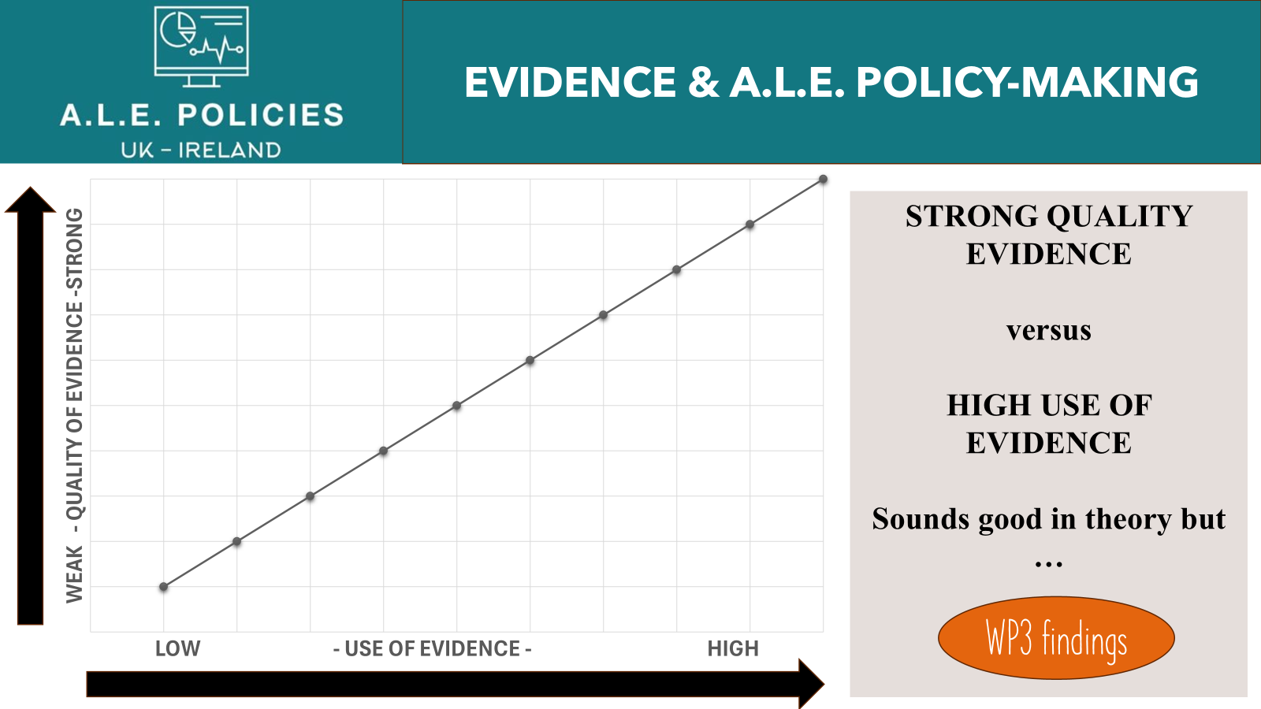
International organisations
International organisations
“I think the methodological shortcomings are not of the kind that they invalidate the main policy conclusions...we could calibrate the responses to the composition of the adult population afterwards…there is no better way of addressing those issues…that’s why I think the reliability and validity are still…more than acceptable.” – OECD P1
“on the whole they are reasonably reliable…but more because of policy development, they might not be reliable for pure scientific research purposes. But for our purpose they are reasonably reliable….they are…not 100% reliable but reliable enough to draw some general conclusions.” – EC P2
“I think you have more reliable data, less reliable data” – EC P1
“…there’s an accumulation of evidence that can drive policy recommendations in a way that really is more evidence informed, right? It’s really not the case in adult education and learning, there’s just not been anywhere near the kind of research, attention to developing independent data that’s viable or validated...So you have a really broad spectrum of information that you received in terms of the quality and validity of information…” – UNESCO P1
“I think sometimes the rigour or the validity is somewhat compromised by the drive to be representative of as great a number of member states as possible.” – UNESCO P2
“I try to have a comprehensive picture of adult learning and education, and I still have a lot of black boxes. And data would be very useful on some aspects of adult education and do not exist yet.” – UNESCO P3

Slide 24
International organisations
International organisations
Problematic use of minimal evidence to promote specific agenda

Slide 25
International organisations
International organisations
“Sometimes data are used mainly to convince people about the importance of the policy…we are serving some high civil servant by providing them a rationale to do their policy.”
– UNESCO P3
Problematic use of minimal evidence to promote specific agenda

Slide 26
International organisations
International organisations
Limited resources
(e.g. funding, time, human capital)

Slide 27
International organisations
International organisations
“Certainly cost is a major reason why we don’t have this data…resources are limited”
– OECD P1
“we try to spend as much time as possible listening to country representatives about their own context. And they may have studies which back up their assertions and their work, but we just don’t have time to get into the more scientifically rigorous side of things.”
– UNESCO P2
Limited resources
(e.g. funding, time, human capital)

Slide 28
International organisations
International organisations
Complexity of ALE
Lack of coordination
Fragmented data

Slide 29
International organisations
International organisations
“we could be using it better…it’s quite fragmented…you have different sources of evidence and data across the board…in a perfect scenario there would be better coordination and a centralised way of putting all the input together…hopefully…if we continue using the data…it can get better and also get used better in policymaking.”
– EC P1
Complexity of ALE
Lack of coordination
Fragmented data

Slide 30
International organisations
International organisations
Balancing socio-political concerns and institutional context

Slide 31
International organisations
International organisations
“…it’s a two way kind of process…we want to do what they expect, but at the same time we want to nudge them into what we think evidence shows us is a successful or a good way to proceed in…you’re constrained…as a public body you have limited budget and resources that you can use. So you’re trying to find a balance in between both the political and the resource base…” – EC P1
“…it’s a balance because we are the service of member state, so we cannot upset them as well. So it’s never easy. ”– UNESCO P3
Balancing socio-political concerns and institutional context

Slide 32
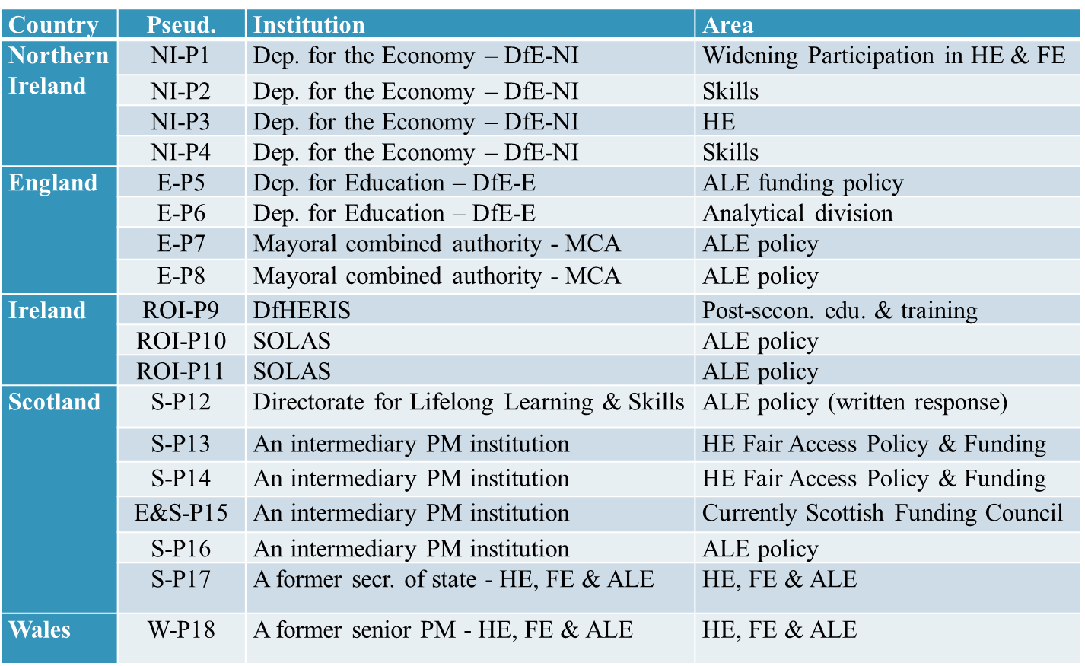
Policy-makers
PARTICIPANT TABLE
POLICYMAKERS

Slide 33
Policy-makers
Types of Evidence
Variety of sources of evidence
Governmental research
Research commissioned or funded by the government
Research by think tanks
Research by international organisations
Research from specific academic institutions
Research by businesses
Academic research
Politics of knowledge production and use
Evidence source prioritised over quality or robustness
‘Whose knowledge?’
rather than
‘Which knowledge?’

Slide 34
Policy-makers
Evidence
use
INSTRUMENTAL | CONCEPTUAL | LEGITIMISATION
To identify problems | To shape understanding of policy problem | To legitimise policies rather than guiding them
To shape policy | To reframe how policymakers think about a problem
To decide where funding goes
To evaluate policies
“in the absence of an executive here, we felt that you needed the credibility of an organisation such as the OECD to be able to sell the strategy… [so it’s not] something that was cooked up in a civil service department in the centre of Belfast.” NI-P4
Especially critical in politically sensitive or underfunded areas.
Involvement of OECD and external actors boosts credibility and to fills the political vacuum especially in the absence of a minister.
Absence of robust evidence can lead to abandonment of well-supported strategies.

Slide 35
INSTRUMENTAL USE
To identify problems
‘But we know that the big challenges for us are around, number one, probably lifelong learning. There’s a long way to go to reach those kind of OECD average levels and beyond. …there was reference to … I think by 2030, Ireland would need an additional 560,000 lifelong learners to get us to there, right, so that’s a lot of work’ (ROI-P10)
To shape policy
‘on the back of PIAAC in 2012… there was a campaign supported by various actors for Ireland to develop a new strategy for literacy, numeracy and digital literacy. That commitment was made in all the political party manifestos in the 2019 General Election. ..In 2020, …the new minister tasked Solas with developing that new strategy. (ROI-P11)
To evaluate policy
‘our role is to try and use a data and evidence analysis across the policy cycle, so starting off from your like rationale intervention, what options we have, costs and benefits and appraisal stuff, through to monitoring what’s going on and evaluating effectiveness of policies later on and then feeding all that back round in the policy cycle.’ (E-P6)
Policy-makers
Evidence Use

Slide 36
INSTRUMENTAL USE
To make funding decisions
‘We generate a lot of administrative data essentially…. We obviously have a system by which we keep track of what the money is being spent for, and where it’s going and so on. That’s kind of like part of the funding system.’ (E-P6)
To make funding decisions
‘So, we have our funding model that allocates out places and money to the institutions, and that’s driven by data metrics. So, the data is automatically driving the funding model. ’ (S-P14)
To make funding decisions
  ‘…through strategic performance process, we have these targets…we have monthly updates on those targets. …. …We collect the evidence to see are we getting there. …we start to fund on the basis as much as possible of that performance married with our strategic ambition.’ (ROI-P10)
Policy-makers
Evidence Use

Slide 37
CONCEPTUAL USE
Shaping understanding, reframing how policymakers think about a problem
‘there’s a lot of inequality, particularly amongst adults with lower qualifications from school… The Skills Barometer showed that there would be less and less opportunities for people with low level qualifications… So, if you’re going to deliver on those strategic goals, then you really need to tackle the skills amongst those already working. And then a sub-set of that is how do you address those issues of equality, diversity and inclusion. So female participation in employment …There’s also extremely poor results for people with disabilities. Socio-economic disadvantage, all those factors play into education outcomes and then employment outcomes. And we can extrapolate that through then to the level of economic and social strategies, and how do we effect change at that basic level of skills that will improve the social and economic circumstances of people living here?’ (NI-P4)
Policy-makers
Evidence Use

Slide 38
Policy-makers
Evidence
use
Mini Case 1: Scotland's ‘Adult Learning Strategy: 2022-2027’
The Adult Learning in Scotland: Statement of Ambition (2014) and the subsequent Adult Learning Strategy: 2022–2027 represent rare examples of ALE policy documents that articulate a comprehensive vision beyond economic utility and acknowledge adult learning’s contributions to confidence, wellbeing, and civic participation.
Both documents were grounded in extensive stakeholder engagement, and both included visionary language supported by strategic frameworks. However, their long-term impact was undermined by the lack of sustained political commitment and, crucially, a weak underpinning in scientific evidence.
As one interviewee noted, the 2022 strategy was shelved almost immediately after a ministerial change, with the incoming minister unconvinced of its legitimacy due to insufficient empirical backing.
This case demonstrates how, despite strong conceptual framing and participatory development processes, a lack of robust, policy-relevant evidence can render ALE strategies politically vulnerable – particularly when their legitimacy is not grounded in robust evidence but dependent on individual ministers’ willingness to champion them.

Slide 39
Policy-makers
Evidence
use
Mini Case 2: Using OECD Evidence to Legitimate Skills Policy in NI
In Northern Ireland, the development of a new skills strategy in the absence of a functioning executive illustrates how evidence can be instrumentalised for legitimacy rather than purely for informing policy content. Faced with political gridlock, civil servants sought to validate their proposals by involving the OECD, a globally recognised authority.
As one policymaker stated, “we needed to have that weight behind it.” The OECD’s involvement provided external validation, ensuring that the strategy would be taken seriously by stakeholders and decision-makers alike.
In parallel, the Northern Ireland Skills Barometer –an evidence source available since 2015– offered recurring data on labour market demands, justifying the inclusion of lifelong learning as a strategic priority. The incorporation of such tools helped present the strategy as evidence-driven, even when ministerial leadership was absent.
This case reveals how evidence can serve dual purposes: informing content and bolstering the strategy’s legitimacy in politically uncertain conditions.

Slide 40
Policy-makers
Evidence
use
Mini Case 3: The Diamond Review and Tuition Fee Grant in Wales
Upon assuming office in 2011, a senior Welsh policymaker was constrained by a pre-existing commitment to the Tuition Fee Grant – a policy that heavily subsidised higher education fees for students in Wales. While politically popular, the grant consumed a disproportionate share of discretionary government expenditure, accounting for approximately 7% of the Welsh Government’s total £16 billion budget. This left limited funding for other crucial areas.
Although the policy’s long-term sustainability was in doubt – particularly under the financial strain of post-2010 austerity – there was a manifesto commitment to preserve it throughout the parliamentary term. Directly challenging it risked political fallout. To navigate this, the policymaker commissioned an independent review (later known as the Diamond Review) tasked with evaluating the funding model and recommending alternatives. Importantly, the review was timed to conclude shortly before the next election cycle, thus creating political space for its recommendations to be adopted by the incoming government, regardless of its party alignment.
What works? vs. What works politically?

Slide 41
OTHER FACTORS INFLUENCING POLICY-MAKING
Personal beliefs and experience
Ministerial priorities
Policy legacies
Unexpected events
Institutional constraints
Financial limitations
Stakeholder engagement
Policy-makers
Other factors

Slide 42
Personal interests, beliefs, background and professional experience
  Responsibilities of the role
  ‘As policy makers, we do not let personal stance impact on the decision-making process - in line with the Civil Service Code values of integrity, honesty, objectivity and impartiality.’ (S-P12-Inst.R.)
Despite civil service codes of neutrality, evidence use reflects the cognitive and experiential resources individuals bring to policymaking.
Policy-makers
Other factors
  Preferences for quantitative data
  ‘I don’t think you’ll find too many civil servants who say they prefer qualitative data over quantitative data… There is a comfort blanket in quantitative data because… Quantitative data’s black, it’s white, it’s right, it’s wrong. So, there is a natural preference for that. (NI-P2)
  Personal norms and beliefs
  ‘For me, I think any policy or strategy should get whoever it is about. So, if it’s an adult learning strategy, it should get the voice of the learners. So that’s always at the forefront of my mind. It shouldn’t just be written by a Scottish Government department. It needs to be out and speaking to the people who it’s actually affecting.’ (S-P16)

Slide 43
Personal interests, beliefs, background and professional experience
Interviewees bring different expertise and background in research skills
  Background, skills and experience in research methods
  ‘Learner voice actually does involve some specialist skills, and I have not done it.’ (NI-P3)
Policy-makers
Other factors
  Background, skills and experience in research methods
  ‘Analytical Services branch are supposed to do this horizon scanning… but they don’t scan the horizon very well, because they don’t look at many academic journals because they either can’t access them or don’t have the time. …The vast bulk of them are either statisticians or economists. So, anything that’s not written in economics, isn’t framed by the economics, they won’t read.’ (E&S-P15)
  Disciplinary cultures among peers
  ‘My previous boss was an economist… So, he’s probably shaped my thinking somewhat as regards the evidence side of things.’ (NI-P2)

Slide 44
Ministerial and political priorities
  Role of minister: Policy-based evidence-production rather than evidence-based policymaking
‘Ministers like to announce stuff, ministers like to do things, and ministers arrive with a priority. Everybody knows the last prime minister loved maths. He thought maths was the solution to most of the world problems, and therefore Multiply came along. …’
‘… part of what we’re looking to evidence is what ministers and decision makers have set out as their priorities at that point in time.’
If you had … a different set of decision makers that are saying, ‘actually our main priority for adult education is to reduce pressure on the health service’, then actually you quite substantially shift what evidence you’re trying to … build.’ (E-P5)
Policy-makers
Other factors
  Minister-bound nature of policy cycles
  ‘Most of the ministers are in post for two or three years maximum. In Wales, occasionally we have one for five years, as we did with Kirsty Williams, but that’s unusual. And in a UK context, it’s more typical that they’re there for two years.’ (W-P18)
  Minister-bound nature of policy cycles
  ‘…what often happens in those circumstances is when a minister leaves, mysteriously the policy disappears. …That’s what happens, a minister moves on ..’ (S-P17-A former secretary of state)
  MINI CASE 1 SCOTLAND

Slide 45
Policy legacy
Mini Case 4: ‘Access to Success’ in NI
The initiative began as a follow-up to the Access to Success (AS) strategy. Although AS had reached the end of its intended timeframe, its legacy continued to shape future policy directions. Before any formal review could commence, however, the Covid-19 pandemic redirected departmental resources and delayed the policy development process. Once activity resumed, an external evaluation, the CFE Report, was commissioned to assess the effectiveness and to generate evidence-based recommendations for the future.
Based on the CFE Report, Widening Access and Participation Forum was created, which brought together representatives from various gov.dept.s, FEs, universities, and others. This forum exemplified the collaborative dimension of policymaking, with stakeholder input informing the direction of policy review and design from an early stage. To operationalise the forum’s work, five task and finish groups were established, each focusing on themes such as evidence, collaboration, and target populations.
The department actively sought broader stakeholder input through regional events and the creation of a wider stakeholder network. Innovative engagement methods – including daytime and evening online sessions, in-person events across regions, and dedicated forums for employers – allowed the department to gather diverse perspectives and feed these into the working groups.
Although evidence was intended to be central to the process, NI-P1 acknowledged that much of what emerged from the working groups was anecdotal or rooted in personal experience. To strengthen the evidentiary base, Stranmillis University College was commissioned to assess the robustness and relevance of the available evidence. Rather than launch a new overarching strategy, the department opted to produce a policy position accompanied by a strategic implementation plan, co-designed with key stakeholders. A further formal consultation will follow to ensure transparency and completeness before final adoption.
Policy-makers
Other factors

Slide 46
Policy legacy & Systems in place
  Systems and infrastructures in place can impede delivering what evidence suggests
  ‘Employers say that we’re not as responsive as we should be. They want programmes to upskill people and retrain people, and they think our system is too slow. They don’t understand that programmes need to be developed, they don’t understand that programmes need to be quality assured, they don’t understand that sometimes you have to then find the people to deliver that programme, fund it, all of those things. And then they’re like, well that’s too slow for us. …Bureaucratic systems aren’t fast in general.’ (ROI-P11)
Policy-makers
Other factors
Infrastructures do not change overnight, and future progress builds on previous legacies and systems that are already in place

Slide 47
Unpredictable and unprecedented events
Unexpected events (e.g. Covid-19, refugee arrivals) disrupt planned evidence-informed processes
Rapid response needs → reliance on institutional memory, practitioner insight, stakeholder voice rather than robust evidence
Evidence often unavailable in real-time → plans adapted without robust data
Policymaking = non-linear, adaptive, contingent
Policy-makers
Other factors
  ‘Our strategy… It started in 2018… and then with the Pandemic, it wasn’t published until maybe quarter two of 2020. So, the Pandemic couldn’t have actually … just before the strategy got implemented, kind of upended where we were going. There was a huge shift to ‘oh my God we’re going to have this unemployment crisis, so we have to create an initiative. What are we going to do?’ We had challenges in our apprenticeship system, and the Ukraine situation… There’s 100,000 or more Ukrainians live in Ireland that need English language training, and that created a huge amount of pressure on the literacy services mainly in the ETBs, which has other unintended consequences, and that’s something we’re working through now. So, all I’m saying is you can have a really nice plan, but ask us next January what our priorities are… Every day is different, every time you open a newspaper, there’s a different type of crisis emerging, so we’ll see what happens next week.’ (ROI-P11)

Slide 48
Institutional constraints - time
  Preference for fast, accessible evidence
  ‘(Policymakers) are incredibly busy people who don’t have much time to go searching for anything, but even when they find it, they don’t have much time to read it. … I think researchers need to think much more about ‘if I want it to make a difference, who are these people? How much time have they got? What skills have they got to pick it up?’ (E-P7)
  Preference for fast, accessible evidence
  ‘I don’t have that time… My own colleagues, they don’t have time either. So, there is just a like trawling through ….And then the timeline stuff is … is just purely a function of working in a very pressurised environment, where the expectations are we turn around things quite quickly, – and this is just a description of reality rather than defence – we tend to reach for the evidence that is nearby. So, if the OECD are doing something, or if I know that UK has done something or France, that’s easier to read and easier to understand rather than having to initiate an engagement out (with academics or academic publications)’ (ROI-P9)
Policy-makers
Other factors
  Limited research capacity in MCAs
  ‘(PMs)…in a government department, with a team of analysts around them… That is just not how MCAs are! There isn’t big research and analytical capability. There are now ten, fifteen of them, all in different places, with actually quite small budgets, and therefore this is a tiny fraction of what they think about.’ (E-P7)

Slide 49
Institutional constraints – skills
  Need for capacity building in terms of analytical skills
  ‘My other problem is that most stakeholders have very limited analytical capacity to read. I mean part of the problem is there’s a blizzard of stuff, you know I could (laughs) cease to do anything else and just look at journals! Which I don’t! I actually very rarely read now. There’s just so much volume of stuff being produced. ’
  ’ (E&S-P15)
Policy-makers
Other factors
Need for research literacy among civil service
Need for enhanced research syntheses
Need for capacity building in terms of analytical skills
‘Everyone in the civil service is a journalist. We don’t promote or run our recruitment systems on the base of specific skills. It is competence based as to what a civil servant needs to do. If there were more emphasis on the capacity for policy research… but there’s certainly, there’s a culture has developed in the absence of that. I can’t think of anyone that works in my sort of direct orbit that would be inclined to go and read a journal, to try and to find evidence that will support a policy decision.’ (NI-P4)

Slide 50
Cross-Institutional constraints
Working in a siloed and fragmented sector
‘The other complexity just when you’re on the budget… our budget for education is split across Department for Education and Department for the Economy. So, that’s really challenging for us, because when people talk about ring-fenced funding for education, they’re talking about schools. So, our colleges and our higher education institutions take a hit because they’ve ring-fenced education. The other issue that we have is that some of the decisions made in DE will impact us, and vice versa. And some of the budgeting challenges, when they’re spread across two departments can be very difficult to resolve especially when there’s two different ministers from two different parties. …It’s obviously DE and DfE are servicing young people in that age group (fourteen to nineteen), but a lot of the remit is split. …Even sharing data between the two departments can be a challenge. Because they’ve gathered data for a specific purpose, but we maybe need it for a different purpose.’ (NI-P1)
Policy-makers
Other factors

Slide 51
Financial constraints
  Data gathering dependent on budget availability
  ‘(If) we think there’s a gap in the evidence base that a survey could fill, we see if there’s a budget for it, and if it’s a priority within the fiscal constraints we have for research spending, and then if it’s a goer, then we can commission it and then get it out in the field and gather the data in.’ (E-P6)
  Data infrastructures need financial support
  ‘It would be better if we had one system that could comparatively …like a dashboard, and I know they do have that in England, but we don’t have that here. … but to do that, there’s significant cost. So, whenever we’re putting up our policy recommendations, we could say …this is something maybe we could consider in future, there’s a cost involved… We would still put up the recommendation but it’s hard to say, given the constrained financial that Northern Ireland, in fact the wider UK is in.’ (NI-P1)
Policy-makers
Other factors
Building sustainable data infrastructures requires strategic investment

Slide 52
Financial constraints
  Funding constraints policy delivery
‘That early interest in lifelong learning that you can see during the period of Jane Davidson’s (Minister for Education, Lifelong Learning and Skills between 2000-2007) role, when she had a strategy on basically kindergarten to old age, that became truncated because the funding wasn’t there. …In my job, the budget for lifelong learning, adult education, reduced to something like one million a year.’ (W-P18)
Resourcing is a prerequisite to open policy windows
(problem, policy, politics streams need money to enable policy change)
Policy-makers
Other factors
  Funding constraints policy delivery
‘It is as brutal as that, if you’ve no money… there’s not much point in trying to have policies… Because …we don’t have any mechanisms to force employers to do much, we don’t involve the broader social partners, we don’t involve stakeholders. So, basically policy is what Government can control and what Government can control is what Government can fund.’ (E&S-P15)

Slide 53
Stakeholder engagement
  Uneven chances to stakeholder engagement
‘Now my frustration with all of that, and it’s a bit like the consultations as well. So, we would put out questions or we would put out policy documents and ask for people to respond. The people with the deepest pockets had the most amount of time to provide a response. So rich people get to influence, and poor people don’t. The universities would spend fortunes. They would also arrange dinner parties for ministers. But …x… (a small organisation) would have no influence because they had no money, and that would mean that they were given less money, because some of these other bodies were able to lobby and also threaten to brief the opposition or to brief the media, or to organise some political disruption, which they did regularly threaten to do.’ (W-P18)
Policy-makers
Other factors
  Small country setting can limit circulation of ideas
‘…but sometimes it’s a bit circular. You know, because Scotland’s quite small, so there’s the same organisations kind of having policy discussions!’ (S-P14)
  New perspectives on evidence
They (AONTAS) ’re very big in trying to raise the learner voice …. When I started this job, I sort of … very heavy on the statistics around the strategic goals. But certainly, when you get talking to learners and hear some of the stories, you sort of think, aye, there’s more to this than that. We can’t just keep that (quantitative) focus.’ (NI-P2)

Slide 54
Policy-makers
Types of Evidence
 | England - Central | England - MCAs | Scotland | Wales | N.Ireland | Ireland
Data type | Heavy reliance on quantitative | Quantitative - Mixed | More reliance on qualitative | Quantitative - Mixed | Quantitative - Mixed | Quantitative - Mixed
Learner voice | Scepticism | Prioritised | Heavily prioritised | Mixed findings | Prioritised | Prioritised
Strong focus on evaluations | - | Mixed findings | Inconclusive | Inconclusive | ✓ | ✓
Expert curation and filtering via analytical divisions | ✓ | - | Inconclusive data | Inconclusive data | Heavy reliance | Heavy reliance
Need for longitudinal data | - | ✓ | ✓ | ✓ | ✓ | ✓
Need for more granular data | - | Strongly needed | ✓ | ✓ | ✓ | ✓

Slide 55
No. | Country |  | No. | Country
E1 | England | Think Thank | S6 | Scotland | Adult and Comm Learning
E2 | England | College | S7 | Scotland | College / University
E3 | England | Adult and Comm Learning | S8 | Scotland | Qualifications Framework
E4 | England | University | S9 | Scotland | Adult and Comm Learning
E5 | England | Think Thank | W1 | Wales | Adult and Comm Learning
E6 | England | Think Thank | W2 | Wales | Adult and Comm Learning
E7 | England | Trade Union | W3 | Wales | College
E8 | England | Trade Union | W4 | Wales | Trade Union
E9 | England | Trade Union | W5 | Wales | Trade Union
E10 | England | Adult and Comm Learning | W6 | Wales | Trade Union
E11 | England | Adult and Comm Learning | W7 | Wales | Trade Union
S1 | Scotland | Adult and Comm Learning | W8 | Wales | Trade Union
S2 | Scotland | College | NI1 | N’Ireland | College
S3 | Scotland | University | NI2 | N’Ireland | University
S4 | Scotland | University | ROI1 | RO Ireland | Adult and Comm Learning
S5 | Scotland | Adult and Comm Learning
Stake-holders
Sample

Slide 56
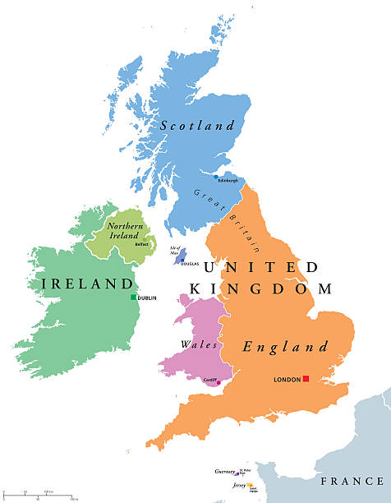
SIT ON WORKING GROUPS
ACTIVELY COLLABORATE TO SOLVE PROBLEMS
SIT ON A VARIETY OF WORKING GROUPS AND COMMITTEES
BRIEF DECISION-MAKERS ON WORK (REPORTS / EVENTS)
COLLABORATE WITH OTHER STAKEHOLDERS AT REGIONAL AND LOCAL LEVEL
Stake-holders
Modes of engagement
RELATIONSHIPS
SIT ON GROUPS
CONSTRUCTIVE FEEDBACK LOOPS
RESPOND TO CONSULTATIONS
ORGANISE EVENTS AND CAMPAIGNS
  LOBBY
  GET YOURSELF ON WORKING GROUPS
  PUBLISH IMPACT REPORTS
RESPOND TO CONSULTATIONS
  SIT ON WORKING GROUPS
  PICK THE PHONE
  HAVE INFORMAL CONVERSATIONS
  BE A TRUSTED PARTNER IN DECISION-MAKING

Slide 57
Republic of Ireland
‘we’re in a really lucky position that our Govt funds NGOs to be their partners and like critical friends. …we’re still in a position to be able to publicly call them out, criticise them, question them, run campaigns against them, and they still fund us.’ ROI1
Northern Ireland
‘it’s a small place, we have to work together in policymaking, we have to, because we’re too small a region not to … the benefits of being able to work much closer in partnership. … to have conversations, to challenge and to make those connections between policymakers, communities, education providers and others.’ NI2
Scotland
Well, we always work very collaboratively … you know we have to, … we’re a very small organisation … it’s always in the relationships and the carrying out the work that you promise to do, and I think the relationships that are sustained through partnership come through those worked through agreements, people carrying out work that they do. S5
Stake-holders
Modes of engagement

Slide 58
Wales
‘the Welsh Govt worked with us on legislation and past legislation that essentially enshrined in Welsh law us as trusted partner status, and as part of that, part of the law created what’s called the Social Partnership Council, where Trade Unions, Welsh Govt and employers all sit to talk through the big issues effectively. We had a major hand in developing that legislation, and as a result we have a permanent presence on that council’ W7
England
‘The biggest sort of piece of influencing you know that we could do at the moment is around Skills England, but you know we don’t … we’ve made our representations but we’ve not heard anything, we’ve not been invited into the conversation. So it’s almost ? … we say we’re interested in talking and then it’s a little bit hit and miss whether we ever you know get round the table and influence it before it’s decided.’ E11
Stake-holders
Modes of engagement

Slide 59
Barriers and Enablers of Stakeholder engagement
ENABLERS
Relationships | ‘I think the relationships are really important’ E2
Willingness | ‘the extent to which the Govt is interested in the agenda and prepared to engage or not’ E4
Alignment with values | ‘any success that there has been … was really attributable to the commitment of institutions, the belief and importance’ S4
Alignment with policy priorities | ‘it wouldn’t be my first choice but we do place an emphasis on economic because that’s where Govt sits’ S6
Stakeholder reputation | ‘[We are] in place for over fifty years, they know that they can trust us, we do good work’ ROI1
Targeted communication | ‘this will be disseminated to Central Govt through our policy briefs, through engagements, through reports, through community engagement so forth’ NI2
Stake-holders
Enablers

Slide 60
Role of relationships with decision-makers mentioned in all countries
‘We have very, very close relationships with the minister for further and higher education, the Cabinet secretary for education, anybody who’s leading the way in terms of equalities’ W1
‘Lifting the phone, meeting for coffee, excellent basis for partnerships. Partnerships can’t be made through e-mail. Partnerships can’t be made on-line. Partnerships have to be worked on, interpersonal, a real deep understanding of issues, a shared understanding of issues.’ NI2
‘I mean … personally, my relationships are quite good with the policymakers. I kind of make that my priority. So … they feel that they can come for advice as well.’ S8
‘I think the relationships are really important. … some of the relationships are personal, aren’t they, so it’s quite hard to separate my relationship in this job with, I don’t know, the director general for skills. So we’re both doing a job, we’re both professionals, but some of it is personal, you know do you get on with them, can you … do they truly believe they can trust you?’ E2
Stake-holders
Enablers

Slide 61
Change to Labour in England –
alignment with values
‘under the Conservative Govt… we used to write … I would write letters on behalf of like our organisations to … skills ministers, or .. civil servants, but we didn’t get any response really. But now, seeing a big difference that when I do write a letter or fill in a consultation or a call for evidence, I’m actually getting a response, which is much more positive …!’ E8
‘So with Labour it’s been a different experience. We do have lines through … to leading Labour politicians, like the minister Jacqui Smith who’s coming to our conference, etc, etc,’ E1
‘Did lots of work with Labour in opposition to say please, … please adopt this thing, it matters. It went in their manifesto, now they’re in Govt, we’ve been working with them and officials .. to say you know this is what we think it should look like.’ E6
‘If you’ve got a Labour mayor, then you’ve instantly got access to these people and stuff, which you probably won’t have … Yeah, that is the reality of it, is with a Labour administration, your Trade Union movement has instantly got an in.’ E9
Stake-holders
Enablers

Slide 62
Barriers and Enablers of Stakeholder engagement
BARRIERS → ABSENCE OF ENABLERS
BARRIERS
Lack of funding | ‘it’s largely … financial, that they just didn’t want to increase Govt spending by providing … additional funding to people to undertake education’ E4
Competition between policy domains | ‘[We] never held an event for Adult Learners Week, because the focus was very much on schools and very little interest in community engagement’ W2
Lack of substantive expertise among decision-makers | ‘it’s not enough to have leaders who want to do something, they have to, as I say, understand the realities on the ground’ S3
Staff turnover: ministers, civil servants | ‘you bring up relationships with somebody and then they’ve changed department and they’ve gone on, and you have to start all over again, that’s very challenging’ W5
Slow progress | ‘I’m trying to say to my members, we need to be patient, we need to work with ministers, support ministers, recognise that they’re our allies, not fight ministers’ E2
Stake-holders
Barriers

Slide 63
Stakeholders’ take on evidence
Users of variety of evidence sources
Research undertaken by think thanks, academic institutions, governments, international organisations, What Works Centres, L&W
Administrative data
Data from large scale survey programmes
Evidence reviews
Variation in preferences for quantitative or qualitative evidence
Stake-holders
What evidence
Variation in ‘learner voice’ as evidence source
Stakeholders as data generators
Surveys, consultations and focus groups with members / learners
Case studies of work practices
Commissioning of reviews
Impact reports
Tacit knowledge through professional experience

Slide 64
Stakeholders’ take on evidence
‘So we started to get a bit more causal and scale evidence… So I feel like there’s lots of correlated evidence, and I think it must be true, but I don’t know that it’s the best way to do it, or that it had the effect’ E6
REFLECTIONS
From anecdotal to causal
Accumulation of professional insights
Stake-holders
What evidence
‘Isn’t that crazy, because any research or having the conversation with one person could be considered anecdotal, but if you meet with enough people, you put that together, you identify a pattern, and isn’t that what all research is, you create statistics. Like so if we meet 3,000 learners, we clearly have a strong evidence base of their profile, their area that they live in, the type of situation they’ve grown up in, and the challenges, the barriers that they’re facing. Like that is hard data.’ ROI1

Slide 65
Stakeholders’ take on evidence
REFLECTIONS on the ‘emotional power’ of learners’ stories
Mostly in combination with other sources of evidence
‘obviously you know in reality, telling stories, you know, having examples of stories is more powerful generally in influencing people, … is actually I think equally powerful for politicians as well’ E4
Stake-holders
What evidence
‘[Research] … many of which will be qualitative, looking at the experience of groups of students, that’s always decisive in scientific terms … that kind of more human scale evidence can be quite persuasive I think to policymakers, because they can relate to it.’ S4

Slide 66
Stakeholders’ selection of evidence
factors
Reputation | ‘IFS, EPI, London Economics’ DH England ‘like that Learning and Work stuff I’m normally very happy to use because I know that that would have been sense checked, so that’s the first thing’ E3
Reflections on methodology | ‘Well the evidence has to be valid and it has to be quality.’ NI2 ‘Well we don’t really use scientific evidence, we would do our own kind of … professional learning group, working group’ S5 ‘I wouldn’t necessarily look at the methodology. Maybe that’s something I should start doing, to be honest’. E8
Relevance to decision-makers | ‘I’m trying to think from a policymaker and a delivery provider’s perspective, what am I going to do with this report? You know what should I take away? What should I do as a result? Rather than just, oh yeah, that’s nice!’ E6
Reflections on cherry picking | ‘But to be honest, you know sometimes you pragmatically … if a piece of evidence suits your argument, you are going to use it! (laughs) But obviously the more robust the organisation that is providing that evidence, the better.’ S8
Data that show progress and argue for funding | ‘That’s a quid pro quo for the money that they give us, they ask us to report on what they are doing with that money that they give us.’ S9 ‘each individual project has to complete quarterly reports of evidence as to the progress of their individual project’ W4
Stake-holders
How to select evidence

Slide 67
Stakeholders’ views on barriers to evidence use
International organisations
Misalignment with (funding) priorities and ideology
Limited access to data and research outputs
Complexity of the sector
Misalignment with (funding) priorities and ideology
Lack of evidence
Data gaps

Slide 68
Stakeholders’ views on barriers to evidence use
International organisations
Misalignment with (funding) priorities and ideology
‘the political process is semi-rational, I would argue. So evidence doesn’t necessarily you know … it doesn’t matter how much evidence you put forward’ AF England
‘Against all the evidence. In fact there’d just been a study done by … I think it was the University of Leeds had said you know what a good job it was doing and he just axed it [Union Learning Fund].’ MP England
‘it didn’t suit his narrative. He’s not the only one, right?!’ SP England
‘there’s a battle as well between trying to promote what you do and say … when there is like the age of austerity or when there’s budget cuts …’ Wales
Misalignment with (funding) priorities and ideology

Slide 69
Stakeholders’ views on evidence use
International organisations
'if you’re allowed to share your research, write blogs, tweet about it, make Instagram posts, like just make it as accessible as possible, tiny little pieces of it that make people interested’ DL ROI
‘We do not get information from anybody in Scotland, because we do not have anywhere that we can access that information easily, unless we look up the website, and not everybody puts things on the website.’ FB Scotland
Limited access to data and research outputs

Slide 70
STREAMLINING OF DATA
LEARNER VOICES AND STORIES
VOLUNTARY SECTOR DATA
PIAAC
Stake-holders
Data gaps
CAUSAL EFFECTS RESEARCH
LONGITUDINAL DATA
COMPARATIVE STUDIES
FINE-TUNED RESEARCH ON BARRIERS
OUTCOMES AND BENEFITS
PLACE AND CONTEXT BASED GRANULARITY
HEALTH
LEARNING BEYOND WORK
TRACKING

Slide 71
STREAMLINING OF DATA
‘So I think the immediate priority is doing better with what we have. … not an unrealistic but an unfair ask, to ask for more data if you already have data and you’re not using that to its maximum potential. … we need to make more of the data that we already have. That I think should be the first priority.’ S2
Stake-holders
Data gaps
IMPACT EVALUATIONS
'People don’t spend nearly enough time doing their homework on good evidence based policymaking. If you do do that, it makes the implementation much smoother and the evaluation much, much cleaner, because you’re evaluating against deliverables that were designed on the basis of evidence.’ NI2

Slide 72
EVIDENCE & A.L.E. POLICY-MAKING
Findings across 3 groups indicated:
The need for reputable, relevant and accessible evidence, well disseminated between research producers to research users
The need for a less fragmented sector
The need for streamlined and robust data programmes and infrastructures that are attractive to use
FIGURE FROM OECD EVIDENCE SERIES

Slide 73
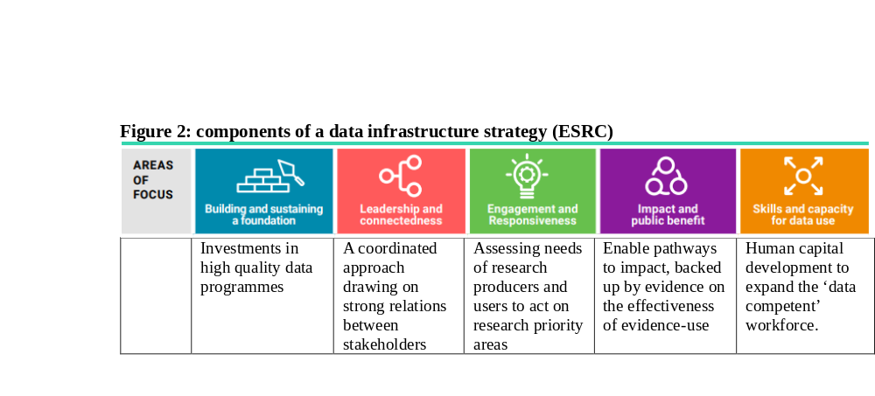
EVIDENCE & A.L.E. POLICY-MAKING

Slide 74
EVIDENCE & A.L.E. POLICY-MAKING
IMPRESSIONS FROM THE AUDIENCE
What do you see as the core take-home message to share with your colleagues in your own work environment?

Slide 75
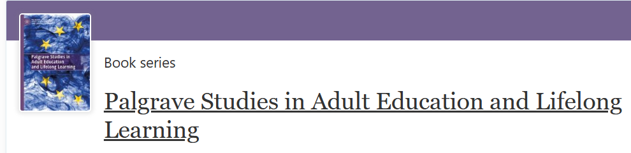
WHAT’S NEXT?
http://adultlearningpolicies.co.uk
25 Years of Adult Learning in the United Kingdom and Ireland:
Trends in Participation and Policies

Slide 76








WHAT’S NEXT?

Slide 77


WHAT’S NEXT?

Slide 78


Scan to read

Slide 79
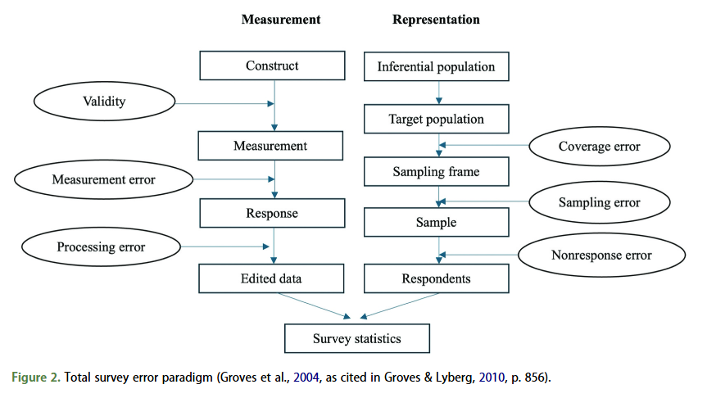

Slide 80
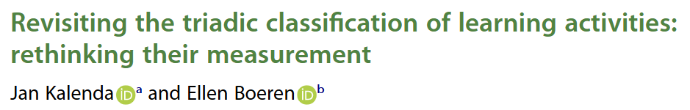
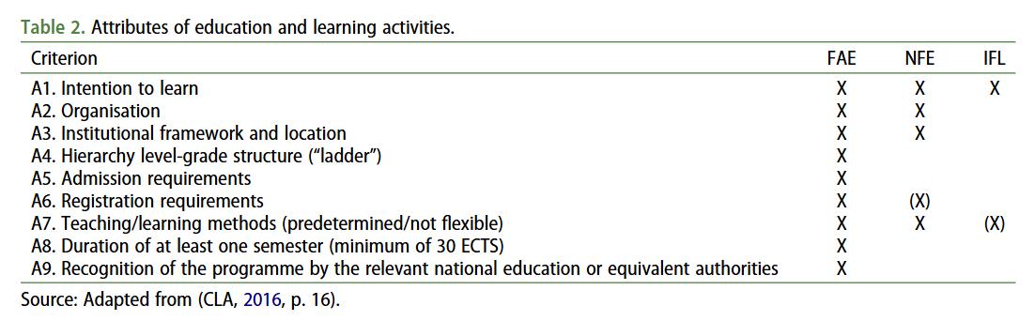

Slide 81
STRATEGIES FOR THE FUTURE
Findings across 3 groups indicated:
The need for reputable, relevant and accessible evidence, well disseminated between research producers to research users
The need for a less fragmented sector
The need for streamlined and robust data programmes and infrastructures that are attractive to use
FIGURE FROM OECD EVIDENCE SERIES

Slide 82
STRATEGIES FOR THE FUTURE
What suggestions can we make to ESRC to support such building of an effective and efficient infrastructure strategy?

Slide 83
TAKE HOME MESSAGES
What suggestions can we make to ESRC to support such building of an effective and efficient infrastructure strategy?

Slide 84
CONCLUSION OF EVENT
http://adultlearningpolicies.co.uk
MANY THANKS to you as an audience
MANY THANKS to our panelists
MANY THANKS to the entire project team at Glasgow and Nottingham
MANY THANKS to the Learning and Work Institute for their support
MANY THANKS to ESRC for funding our work

